Slide 1
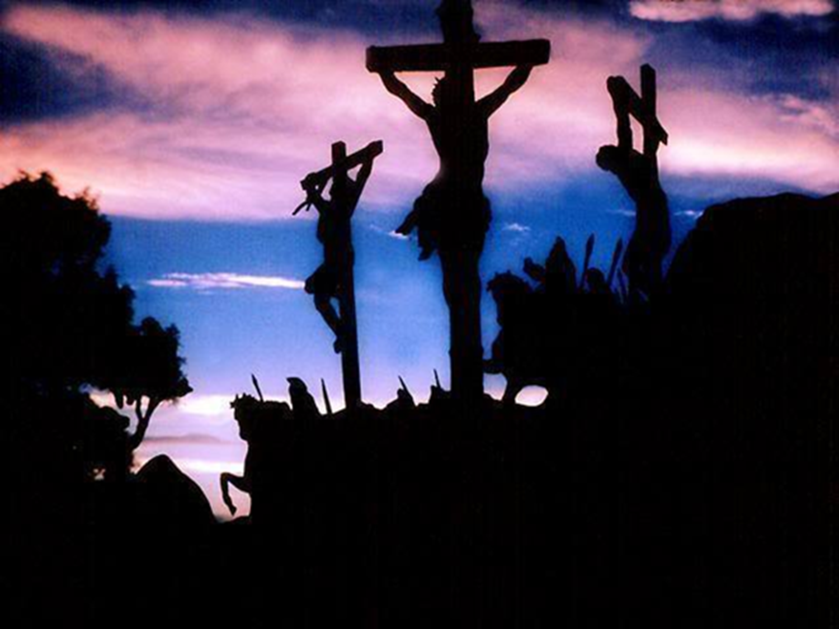
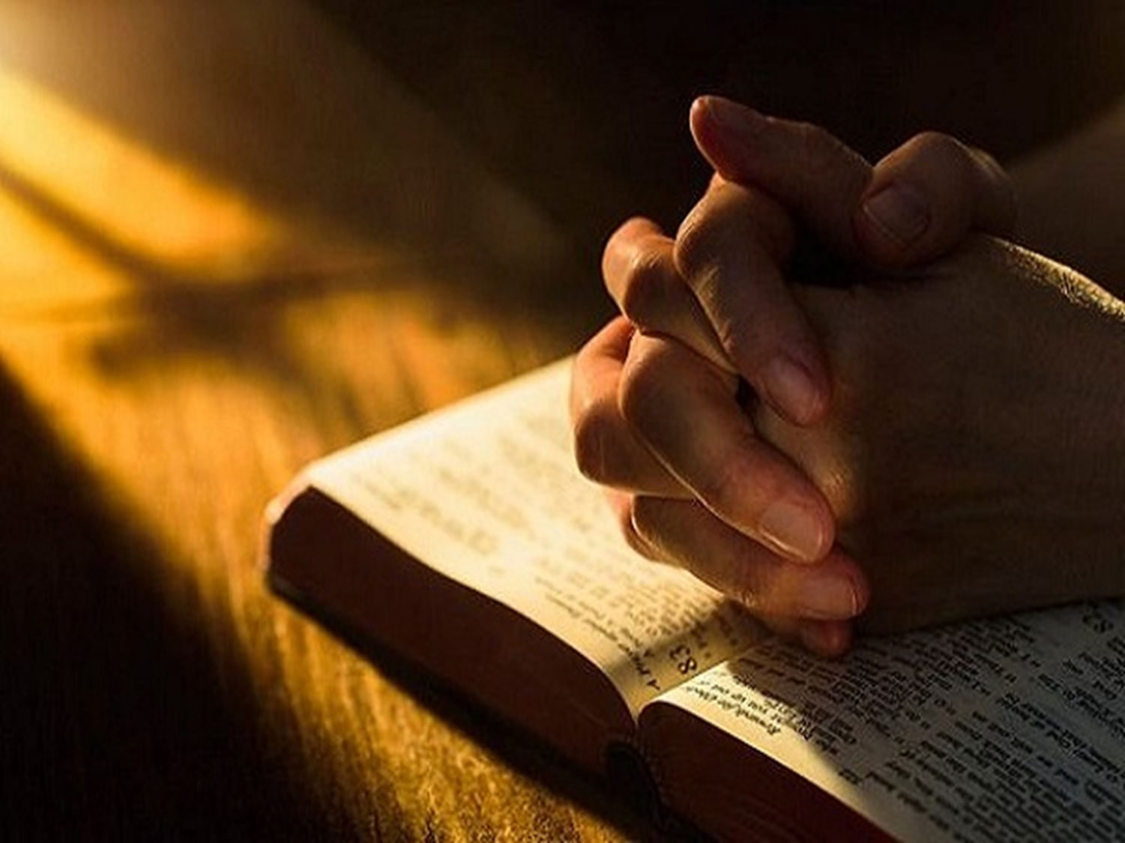
Remembering Jesus
1 Corinthians 11:24

Slide 3
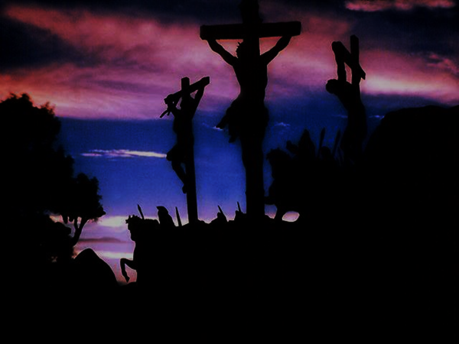

Slide 4
The Sacrifice of Jesus
What was involved in the sacrifice of Jesus?
Jn. 19:31-37; Acts 8:33; Isa. 53; Rom. 5:8
God has provided us with a means of remembering this sacrifice
1 Pet. 1:11-12; Eph. 3:9-11; Rom. 6:3

Slide 7
The Abiding of Jesus
Christians may be assured of daily abiding
Mt. 28:20; Heb. 13:5; Acts 17:26-27; 1 Pet. 3:12
Remember the power of abiding with Jesus
Mt. 28:18; Eph. 3:20-21; Col. 2:3; Jas. 1:5; Phil. 4:19
Remember His presence in temptation, loneliness, and fear
1Cor. 10:13; Heb. 4:15; Mt. 28:20; Heb. 13:5

Slide 10
The Coming of Jesus
The early Christians remembered the promise of Jesus’ return
Jn. 14:1-3; Acts 1:10-11; Phil. 3:17-4:1
We ought to remember that the coming of Jesus is imminent
2 Thess. 2:1-12; Prov. 27:1
We as Christians ought to anticipate the joy of His coming
Phil. 3:21; 2 Cor. 5:1; 2 Tim. 4:8

Slide 11
Remembering Jesus
1 Corinthians 11:24

