Slide 2
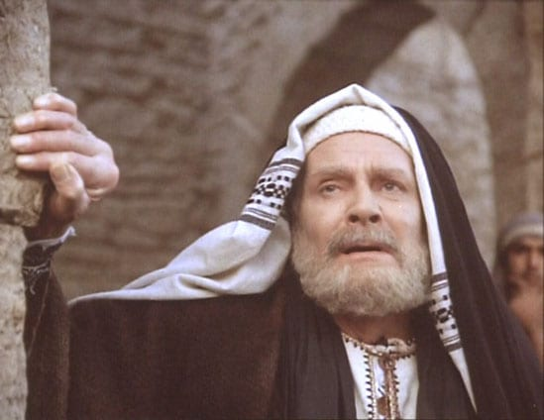
Joseph of Arimathea is a Bible character we often overlook

Slide 3
He appears only once in Bible history and then disappears but his deeds are important enough to be recorded in all four of the gospels
  Matthew 27
  Mark 15
  Luke 23
  John 19

Slide 4
By closely considering him and what he did, we can learn some very important lessons

Slide 5
Joseph of Arimathea
Who Was Joseph of Arimathea?

Slide 6
Joseph of Arimathea
Who Was He?
He was from the city of Arimathea, “a city of the Jews” (Luke 23:51)
  It is believed to be a small city in the territory belonging to the tribe of Ephraim

Slide 7


Arimathea
International Standard Bible Encyclopaedia
“A city of the Jews,” the home of Joseph in whose sepulchre the body of Jesus was laid. Its identity is the subject of much conjecture. The Onomasticon of Eusebius and Jerome identifies it with Ramathaim-zophim in the hill-country of Ephraim (1 Sam 11), which is Ramah the birthplace and burial-place of Samuel (1 Sam 1:19; 25:1) and places it near Timnath…

Slide 8
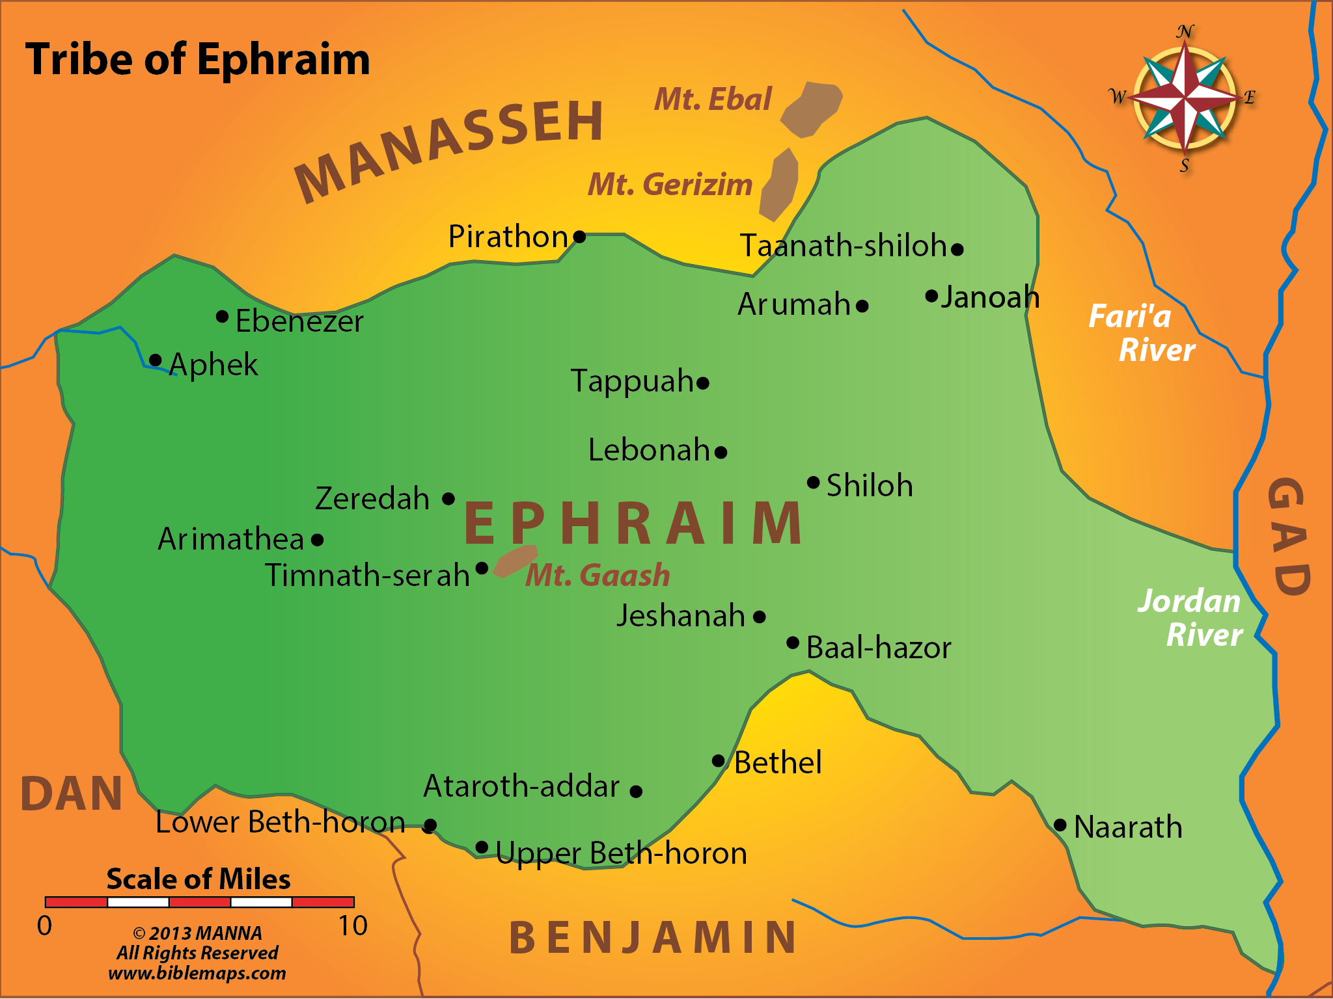

Slide 9
Joseph of Arimathea
Who Was He?
By the time we meet him in Scripture, he apparently is a resident of Jerusalem since he had a tomb for his family there (Matt. 27:57-61)

Slide 10
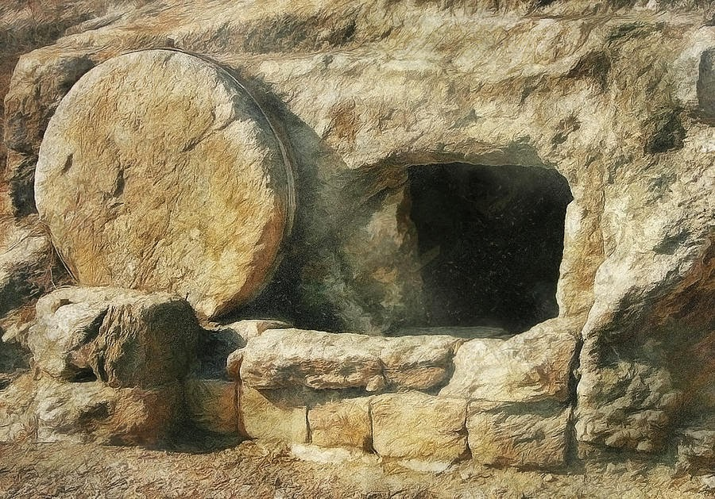
It was a rock-hewn tomb in a garden just outside of the city of Jerusalem

Slide 11
It was a new tomb – no body had been previously placed in it

Slide 12
Joseph of Arimathea
Who Was He?
He was “a rich man” (Matt. 27:57)
  Being rich, his deeds fulfilled prophecy

Slide 13
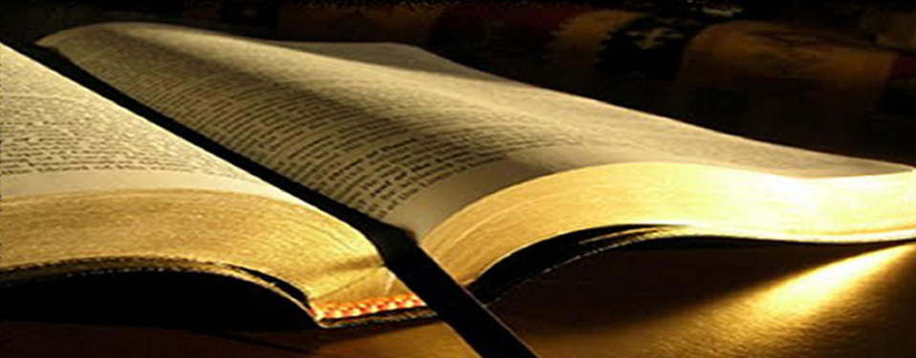
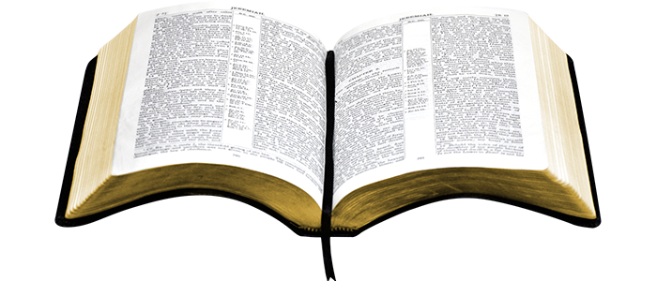
Isaiah 53:9
And they made His grave with the wicked – But with the rich at His death…

Slide 14
Joseph of Arimathea
Who Was He?
He was “a prominent council member” (Mark 15:43)
  He was a part of the Sanhedrin, a group of 70 rulers of the Jews

Slide 15
Joseph of Arimathea
Who Was He?
He was “a good and just man” (Luke 23:50)
  This certainly distinguished him from most of the Sanhedrin who were blood-thirsty murderers
  His moral goodness is seen in the fact that he did not consent when the rest of the council condemned Jesus (Luke 23:51)
  His goodness is seen in that he gave Jesus a proper burial

Slide 16
Joseph of Arimathea
Who Was He?
It is interesting to note that another Joseph was described as “just” (Matt. 1:19)
  That “just” man was the guardian of Jesus at His birth
  This “just” man was His guardian at His death

Slide 17
Joseph of Arimathea
Who Was He?
He was “a disciple of Jesus, but secretly” (John 19:38)
  He feared the Jews
    He, at Jesus’ death, was no longer a secret disciple
  There were other rulers in a similar position
    Nicodemus who came to Jesus by night (John 3)
    Many of the rulers who believed in Jesus

Slide 18
John 12:42-43
Nevertheless even among the rulers many believed in Him, but because of the Pharisees they did not confess Him, lest they should be put out of the synagogue; 43 for they loved the praise of men more than the praise of God.

Slide 19
Joseph of Arimathea
Who Was He?
He “was waiting for the kingdom of God” (Mark 15:43; Luke 23:51)
  This indicates he believed that Jesus would usher in the kingdom
  Thus he looked to Jesus as the Messiah

Slide 20
Joseph of Arimathea
Joseph’s Brief – But Important – Moment in History

Slide 21
Joseph of Arimathea
His Moment in History
He boldly requested permission from Pilate for the body of Jesus (Mark 15:42-45)

Slide 22
Mark 15:42-45
Now when evening had come, because it was the Preparation Day, that is, the day before the Sabbath, 43 Joseph of Arimathea, a prominent council member, who was himself waiting for the kingdom of God, coming and taking courage, went in to Pilate and asked for the body of Jesus. 

Slide 23
Mark 15:42-45
44 Pilate marveled that He was already dead; and summoning the centurion, he asked him if He had been dead for some time. 45 And when he found out from the centurion, he granted the body to Joseph.

Slide 24
Joseph of Arimathea
His Moment in History
Jesus had hung on the cross from the third hour [9 A.M.] to the ninth hour [3 P.M.] (Mark 15:25, 33-34)
  He died around 3 P.M. on Friday

Slide 25
Joseph of Arimathea
His Moment in History
The Sabbath began at 6 P.M.
  According to Rabbinical writings, the few hours before the Sabbath was called “the Preparation”

Slide 26
The Preparation Day
Nelson’s Illustrated Bible Dictionary
The day immediately before the Sabbath and other Jewish festivals. Preparation Day always fell on Friday among the Jewish people, because all religious festivals began on the Sabbath, or Saturday (Matt 27:62; John 19:14,31). 

Slide 27
The Preparation Day
Nelson’s Illustrated Bible Dictionary
With a week of holidays ahead, the Preparation Day for the PASSOVER was especially busy. The details for preparing the Passover supper had to be completed by afternoon. Preparations included baking the unleavened bread, gathering festive garments to wear for the occasion, and taking a ceremonial bath. 

Slide 28
The Preparation Day
Nelson’s Illustrated Bible Dictionary
But above all, the paschal lamb had to be slain. Slaughtering began an hour or more earlier than for the usual daily evening sacrifice. At the Temple, the priests slaughtered thousands of lambs brought in by the people. Their blood was poured at the foot of the altar. Then the lambs were roasted whole in preparation for the Passover meal in each home that evening.

Slide 29
Joseph of Arimathea
His Moment in History
It was contrary to Jewish law to have a criminal hanging on a cross overnight (Deut. 21:22-23; Josh. 8:29)
  The Roman custom was to leave the body for the birds

Slide 30
Deuteronomy 21:22-23
“If a man has committed a sin deserving of death, and he is put to death, and you hang him on a tree, 23 his body shall not remain overnight on the tree, but you shall surely bury him that day, so that you do not defile the land which the Lord your God is giving you as an inheritance; for he who is hanged is accursed of God.”

Slide 31
Joseph of Arimathea
His Moment in History
The Jews did not want the bodies of those crucified to remain on the Sabbath (John 19:31-37)

Slide 32
Joseph of Arimathea
His Moment in History
Joseph “takes courage” following Jesus’ death shedding his role as a secret disciple (Mark 15:43)
  He boldly goes before Pilate and asks for the body of Jesus

Slide 33
Joseph of Arimathea
His Moment in History
He is joined by another ruler – Nicodemus (John 19:38-42)
  He was also a believer in Jesus
    He came to Him by night knowing that He was from God (John 3:1-5)
    He defended Him to the Pharisees (John 7:50-53)
  He now brought spices for Jesus’ burial

Slide 34
Joseph and Nicodemus
A.T. Robertson, Minor Characters in the NT, 11
Two members of the Sanhedrin come forward late Friday afternoon to give decent burial to the body of Jesus. Joseph of Arimathea had been a secret disciple “because of fear of the Jews” (John 19:38). He was a rich man with a new tomb and he had not consented to the dreadful deed of the Sanhedrin (Luke 23:51). 

Slide 35
Joseph and Nicodemus
A.T. Robertson, Minor Characters in the NT, 11
He asked Pilate for the body of Jesus that it might not be buried in the potters’ field. Then it was that Nicodemus, another secret disciple in the Sanhedrin, stepped forward and took his stand by the side of Joseph of Arimathea. He brought a mixture of myrrh and aloes. 

Slide 36
Joseph and Nicodemus
A.T. Robertson, Minor Characters in the NT, 11
These two men of scholarship and wealth now in the hour of deepest shame for Jesus openly avowed their love for Him, and confidence in Him…they…took up their cross when the apostles fled. They gave Jesus a dignified and honorable burial in Joseph’s new tomb to the north of Jerusalem in the garden (John 19:41).

Slide 37
Joseph of Arimathea
His Moment in History
When they took Jesus’ body down to bury it, they would have become defiled (Num. 19:11-13)
  There is no mention that they had servants doing the work
  They would not have been able to fully participate in Sabbath the next day
  They saw a greater need – to properly bury the body of Jesus

Slide 38
Numbers 19:11-13
“He who touches the dead body of anyone shall be unclean seven days. 12 He shall purify himself with the water on the third day and on the seventh day; then he will be clean. But if he does not purify himself on the third day and on the seventh day, he will not be clean. 

Slide 39
Numbers 19:11-13
13 Whoever touches the body of anyone who has died, and does not purify himself, defiles the tabernacle of the Lord. That person shall be cut off from Israel. He shall be unclean, because the water of purification was not sprinkled on him; his uncleanness is still on him.”

Slide 40
Joseph of Arimathea
A Lesson from Joseph

Slide 41
Joseph of Arimathea
A Lesson from Joseph
The events that occurred on that day caused Joseph and Nicodemus to act (Luke 23:26-38)
  Seeing the same events, the apostles forsook Jesus and fled

Slide 42
Joseph of Arimathea
A Lesson from Joseph
Joseph’s attitude of heart – “waiting for the kingdom” – caused him to be emboldened by the events he had witnessed

Slide 43
Joseph of Arimathea
A Lesson from Joseph
His actions were the opposite of the other disciples, especially those of Peter
  Peter spoke boldly then became afraid
  Joseph was a secret disciple who became bold

Slide 44
Joseph’s Boldness
Dwight L. Moody, Bible Characters
I consider this was one of the sublimest, grandest acts that any man ever did. In that darkness and gloom – His disciples having all forsaken Him; Judas having sold Him for thirty pieces of silver; the…apostle Peter having denied him with a curse, swearing that he never knew Him; 

Slide 45
Joseph’s Boldness
Dwight L. Moody, Bible Characters
the chief priests having found Him guilty of blasphemy; the council having condemned Him to death; and when there was a hiss going up to heaven over all Jerusalem – Joseph went right against the current, right against the influence of all his friends, and begged the body of Jesus.

Slide 46
Joseph of Arimathea
A Lesson from Joseph
He no longer allowed fear to cause him to:
  Join in with Jesus’ enemies
  Flee for his life like the other disciples

Slide 47
Joseph of Arimathea
A Lesson from Joseph
The power of fear is great but the power of love is greater

Slide 48
Joseph of Arimathea
A Lesson from Joseph
The cross has the power to overcome the pressures the world may place upon us

Slide 49
Joseph of Arimathea
A Lesson from Joseph
If we have a proper attitude of heart when we carefully consider what Jesus did for us, it will instill within us a spirit of boldness to honor, obey and serve the Lord no matter the consequences

Slide 50
Joseph of Arimathea
Conclusion

Slide 51
We need to take courage from the wonderful example Joseph of Arimathea has given us

Slide 52
By his actions he openly confessed his belief in Jesus when all others – save Nicodemus – were reluctant

Slide 53
We should admire the courage of Joseph and Nicodemus but we must realize we must be characterized by that same courage

Slide 54
Let us stand up and be counted for the Lord Jesus Christ

