Slide 1

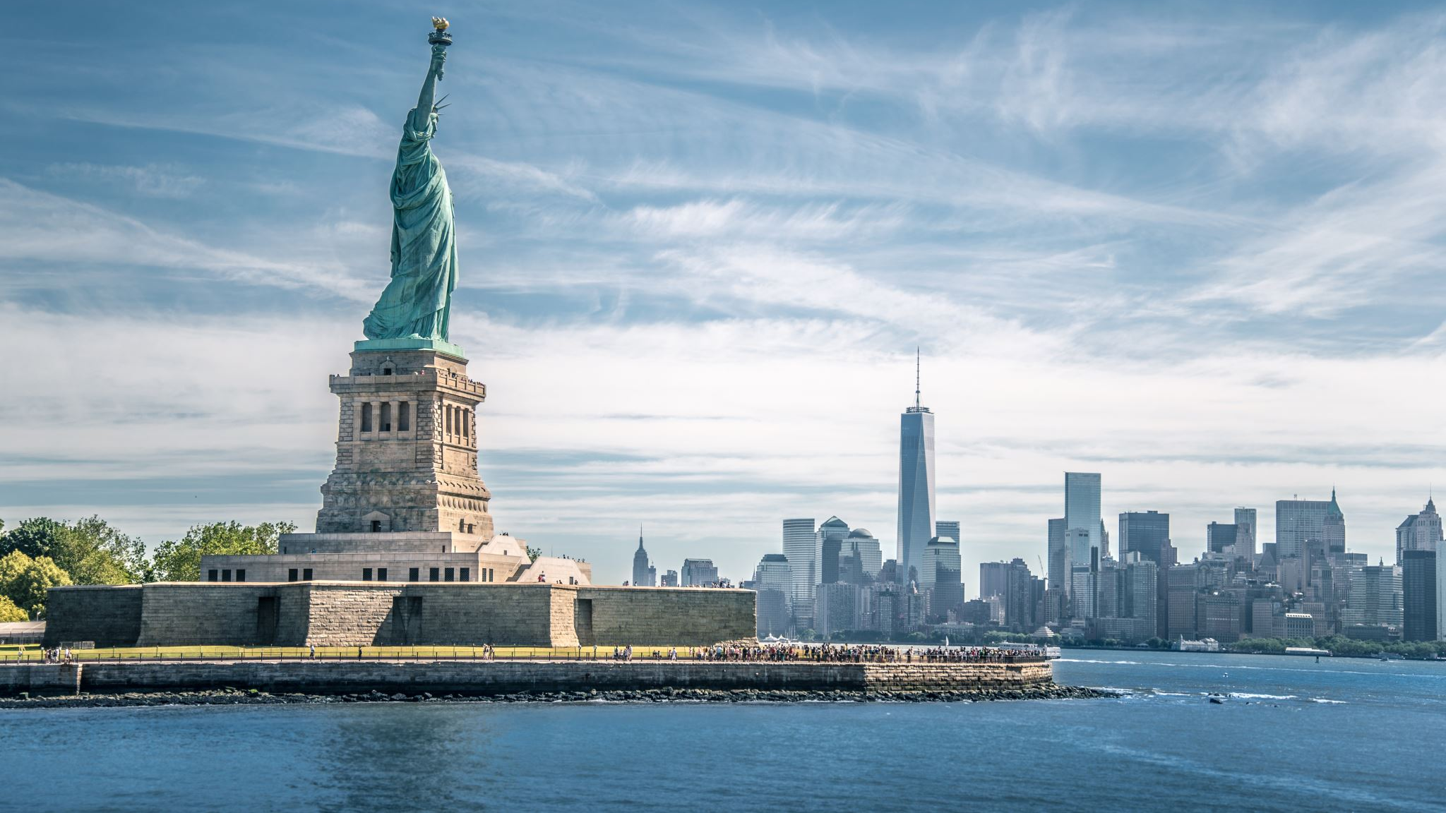
“Liberty”
Luke 4:16-19

Slide 2
He Has Been Anointed
how God anointed Jesus of Nazareth with the Holy Spirit and with power, who went about doing good and healing all who were oppressed by the devil, for God was with Him. ~Acts 10:38

Slide 3
To preach good news to poor
Blessed are the poor in spirit,
For theirs is the kingdom of heaven. ~Matthew 5:3

Slide 4
He has sent Me to proclaim freedom to the captives
Now since the children have flesh and blood in common, Jesus also shared in these, so that through His death He might destroy the one holding the power of death — that is, the Devil — and free those who were held in slavery all their lives by the fear of death. ~Hebrews 2:14,15

Slide 5
and recovery of sight to the blind
As Jesus went on from there, two blind men followed Him, shouting, “Have mercy on us, Son of David!”
When He entered the house, the blind men approached Him, and Jesus said to them, “Do you believe that I can do this?”
“Yes, Lord,” they answered Him.
Then He touched their eyes, saying, “Let it be done for you according to your faith!” And their eyes were opened. ~Matthew 9:27-30a

Slide 6
to set free the oppressed
They came to Jesus and saw the man who had been demon-possessed by the legion, sitting there, dressed and in his right mind; and they were afraid. As He was getting into the boat, the man who had been demon-possessed kept begging Him to be with Him. ~Mark 5:15,18

Slide 7
to proclaim the year of the Lord’s favor
“Repent,” Peter said to them, “and be baptized, each of you, in the name of Jesus Christ for the forgiveness of your sins, and you will receive the gift of the Holy Spirit. For the promise is for you and for your children, and for all who are far off, as many as the Lord our God will call.” ~Acts 2:38,39

Slide 8
so that what was spoken through the prophet Isaiah might be fulfilled:
Here is My Servant whom I have chosen,
My beloved in whom My soul delights;
I will put My Spirit on Him,
and He will proclaim justice to the nations.
He will not argue or shout,
and no one will hear His voice in the streets.
He will not break a bruised reed,
and He will not put out a smoldering wick,
until He has led justice to victory.
The nations will put their hope in His name. ~Mat. 12:17-21

