Slide 1
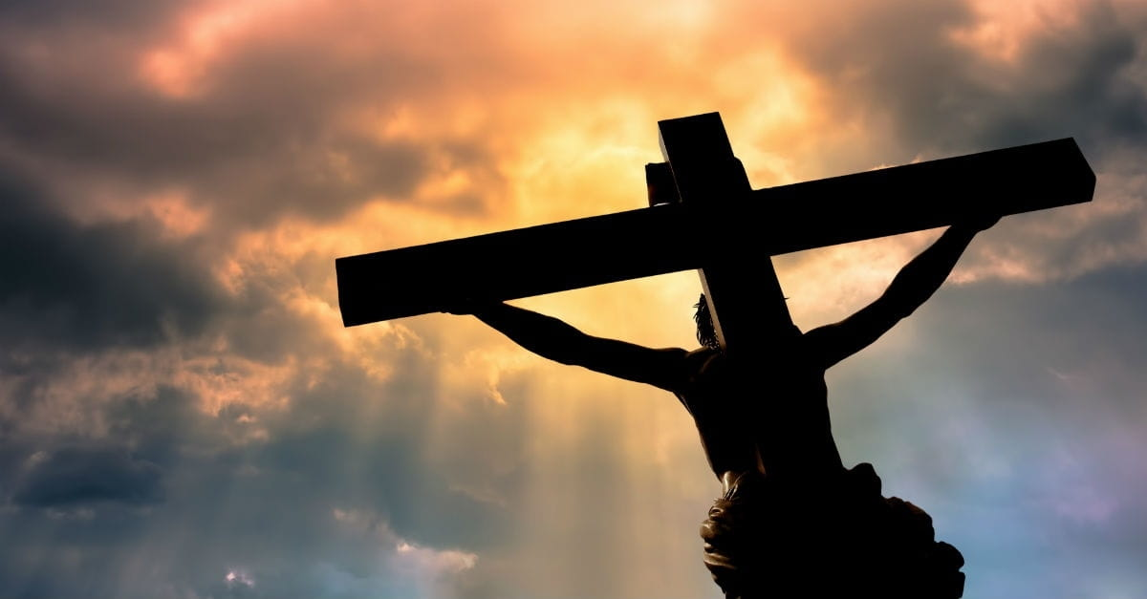
What is the church?
Something you go to?
Something you do?
Ephesians 5:25-27
Where you go when you need something?
Place of entertainment?
The Beauty of the Church

Slide 2
What is the church?
The bride of Christ
Beauty of a bride
Ephesians 5:25-27
The Beauty of the Church

Slide 3
What is the church?
The saved God
Acts 2:47
Ephesians 5:25-27
What is the church?
United believers
Acts 2:44; 4:32
The Beauty of the Church

Slide 4
What is the church?
A changed people
Acts 2:22-23, 37-38, 41-42
Ephesians 5:25-27
The Beauty of the Church

Slide 5
What is the church?
A giving people
Acts 2:44-45
Ephesians 5:25-27
Look how beautiful the church is -
2 Corinthians 8:1-5
The Beauty of the Church

Slide 6
What is the church?
A body of people
Acts 2:47
1 Corinthians 12:27
Ephesians 5:25-27
Many view the church like being a member of Sam’s Club
Romans 12:4-5
The Beauty of the Church

Slide 7
The church, like people, change.
Change can be good or bad.
Ephesians 5:25-27
The church at Ephesus had changed – but that was bad.
Revelation 2:1-7
The Beauty of the Church

Slide 8
Satan has been having his way with churches.
Satan hates the church.
Ephesians 5:25-27
Satan promotes sin, apathy, false teaching and division.
Acts 20:28-32
The Beauty of the Church

Slide 9
Because churches and people change, each must test themselves.
2 Corinthians 13:5
Ephesians 5:25-27
The Beauty of the Church

Slide 10
However, some changes are good.
When there is repentance.
Ephesians 5:25-27
People that repent.
Acts 2:38, 41
Churches too.
1 Corinthians 5
The Beauty of the Church

Slide 11
Church growth is good.
Spiritually
Galatians 5:22-23
Ephesians 5:25-27
Numerically
Acts 5:14; 11:24
Growth prevents Satan from taking over.
The Beauty of the Church

Slide 12
The church and the disciple must learn to deal with changes.
Ephesians 5:25-27
James 1:2-4
God is with us.
God will help us in time of need.
The Beauty of the Church

Slide 13
Please, stop just going to church.
Be the church!!
Ephesians 5:25-27
We are the bride of Christ.
Let each of us be beautiful to Christ and the world.
The Beauty of the Church

Slide 14
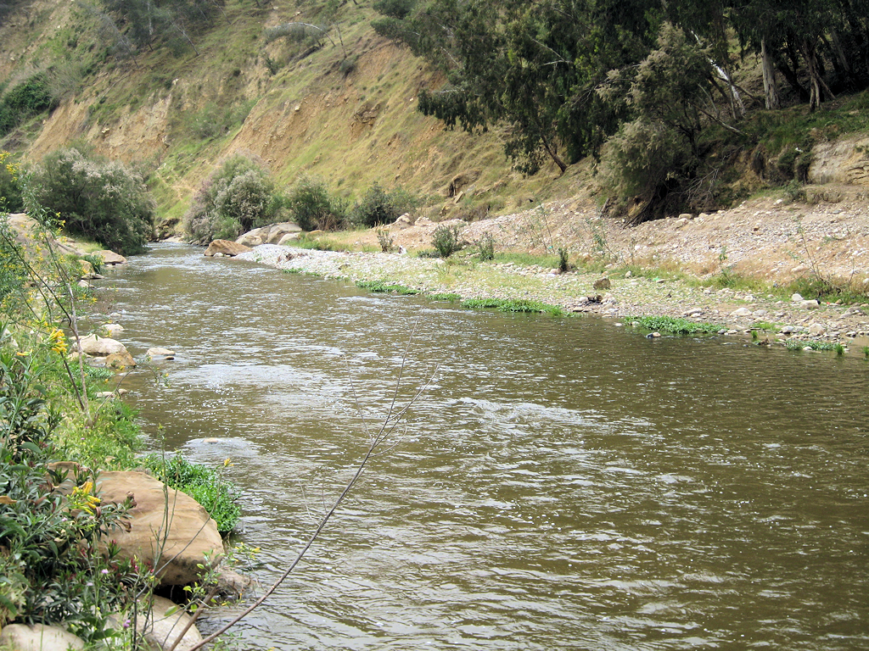
Hear the gospel (Romans 10:17)
Believe (Mark 16:16; Hebrews 11:6)
Repent (Acts 2:38; Acts 17:30)
Confess (Romans 10:9-10; Acts 8:37)
  “I believe that Jesus Christ is the Son of God.”
Be baptized (Mark 16:16; Acts 2:38)
Live faithfully (Hebrews 10:36)

