Slide 2
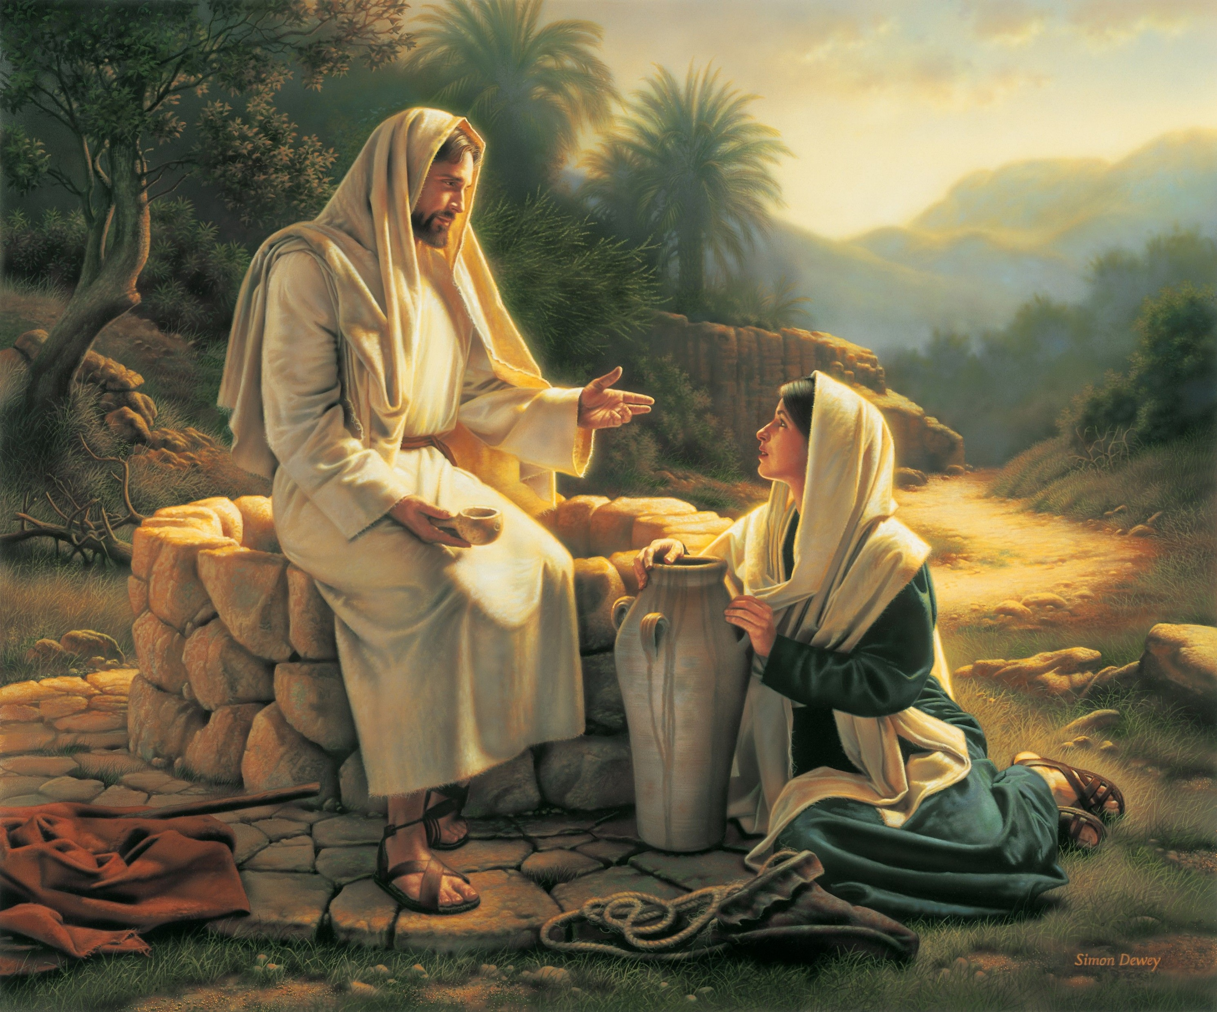
“No one ever spoke like this man!” John 7:46 ESV

Slide 3

Is This You?

Slide 4

Looking For Answers in All the Wrong Places
at work

Slide 5


Looking For Answers in All the Wrong Places
Social media

Slide 6

Looking For Answers in All the Wrong Places
at a bar

Slide 7
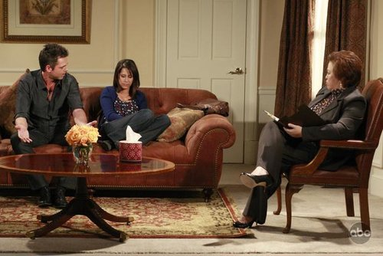

Looking For Answers in All the Wrong Places
worldly counsel

Slide 8

Looking For Answers in All the Wrong Places
ignoring the problem(s)

Slide 9

Have You Really Tried This?
Ask your Father and listen to His counsel.

Slide 10
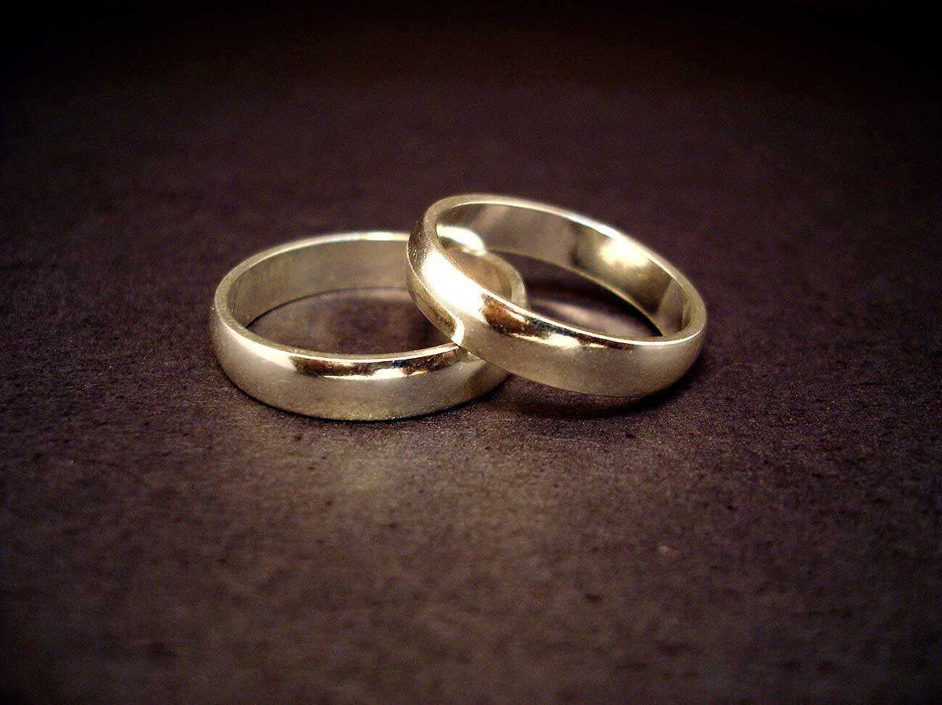
Marriage is honorable.
Marriage is ordained of God.
Marriage compared to Christ and the church.
Marriage is for life.

Slide 11

Marriage is for a man and a woman.
Sexual fulfillment
Rightful bearing of children.
Companionship

Slide 12

Does Your Marriage Need A
?

Slide 13


Married 10 years or less
communication
spiritual growth
time alone – romance
finances / spouse roles
Married 11 – 20 years
communication
time alone – romance
trust and forgiveness
spiritual growth

Slide 14

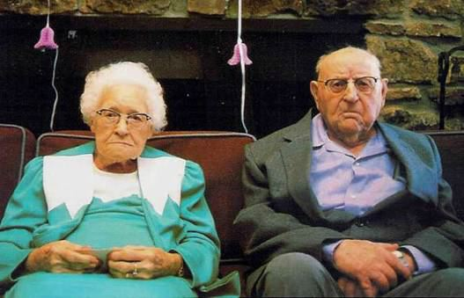
Married 21 – 30 years
communication
time alone – romance
spiritual growth
finances / love and trust
Married 30+ years
communication
spiritual growth
loving each other
time alone – romance

Slide 15
Growing Spiritually
Does Your Marriage Need A
?
How serious are you about going to heaven (Col 3:1-2)?
What exactly are you doing to help your spouse get to heaven?
Do you really understand how important a soul is (Mat 16:24-26)?
The secret of true intimacy.

Slide 16
God
I John 2:3
Getting closer
to God
know
Gets you closer
to each other
Husband
Gen 4:1
Wife

Slide 17
Growing Spiritually
Does Your Marriage Need A
?
How serious are you about going to heaven (Col 3:1-2)?
What exactly are you doing to help your spouse get to heaven?
Do you really understand how important a soul is (Mat 16:24-26)?
The secret of true intimacy.
Make the time to grow spiritually.

