Slide 1
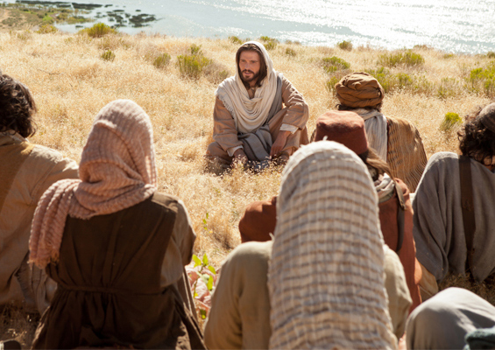
“No one ever spoke like this man!” John 7:46 ESV

Slide 2


“do not worry about your life”
Matthew 6:25 NKV
Matthew 6:24-34

Slide 3
Our trust in God is tested daily Heb 11:24-25
Material possessions is one of our greatest challenges.

Slide 4
3 times the Lord says for us not to worry (Mat 6:25, 31, 34)
Are WE listening?!?!
Where exactly are our treasures (Mat 6:19-21)?

Slide 5
2 treasuries: 1 on earth and 1 in heaven
“treasures” refers to our goals, interests, activities, what is really important to us

Slide 6
Jesus not forbidding the possession of things or saving for a rainy day.
It’s not wrong to possess things, however, it is wrong for things to possess us. Unknown

Slide 7
Jesus is teaching us not to be selfishly hoarding things to the exclusion of putting God first.
Luke 12:15-21
Only heavenly treasures are eternal.

Slide 8
“anxious” means care, thought or worry that is void of trust in God to take care of us
Lit. to be pulled apart – in 2 directions
Eng. to strangle
Luke 10:41

Slide 9
Jesus demonstrates our Father’s great loving care for even the birds, lilies and grass.
“Are you not worth much more than they?” Mat 6:26

Slide 10
How do we stop worrying?
Do all you can to put God first in your life.
“seek first” actively and constantly pursue God

Slide 11
The reign of God in our hearts is primary.
“first place in everything.” Col 1:18
“His righteousness” in context, a changed life

Slide 12
Trust God to take care of the rest.
“Trust in the Lord with all your heart, and do not lean on your own understanding. In all your ways acknowledge Him, and He will make your paths straight.” Pro 3:5-6

Slide 13
Stop worrying!! Our Father is still on His throne and He cares for YOU!!

Slide 15
Obeying the Gospel
Hear the gospel (Romans 10:17)
Believe (Mark 16:16; Hebrews 11:6)
Repent (Acts 2:38; Acts 17:30)
Confess (Romans 10:9-10; Acts 8:37)
  “I believe that Jesus Christ is the Son of God.”
Be baptized (Mark 16:16; Acts 2:38)
Live faithfully (Hebrews 10:36)

Slide 16

“No one ever spoke like this man!” John 7:46 ESV

