Slide 1
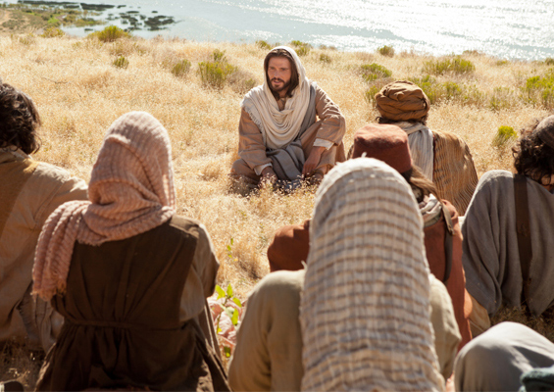
“No one ever spoke like this man!” John 7:46 ESV

Slide 2
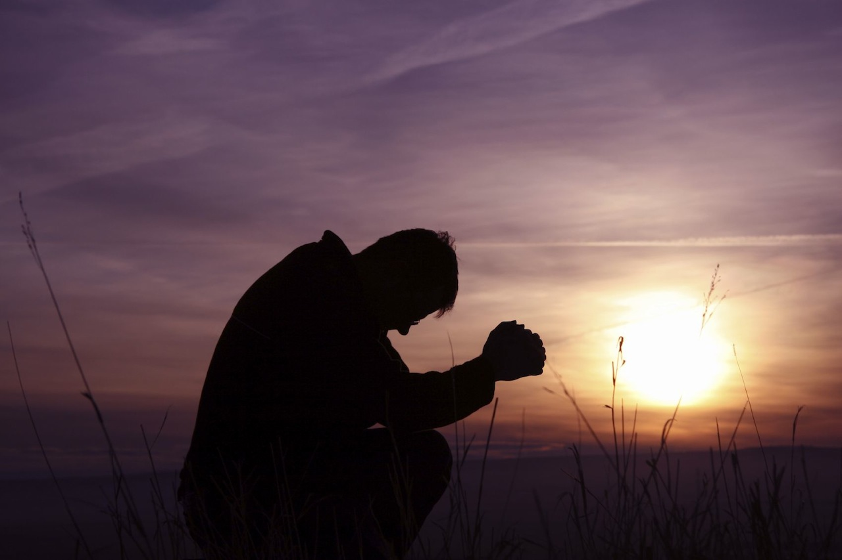
“forgive us our debts”
Matt 6:12-15
“debts”
or
“sins” Luke 11:4
Have we lost our guilt and shame of sin? Jerm 6:15
Are we just “hearing” and “not doing”? Matt 7:24-27
Sin and repentance not a one time for all time issue.

Slide 3
“forgive us our debts”
Matt 6:12-15
How much debt do we really have?
Luke 7:36-50
Have we been forgiven little or much?
“sins have piled up as high as heaven”

Slide 4
“forgive us our debts”
Matt 6:12-15
“deliver us from evil”
“the evil one”
As citizens we must change our lives.
Tempt – temptation – trial
From God for our good
From Satan for our destruction

Slide 5
“forgive us our debts”
Matt 6:12-15
“deliver us from evil”
“the evil one”
We can take great comfort in:
-God controls the devil
-God limits the devil
-Even satan’s attempts at us can be used for our good.

Slide 6
“forgive us our debts”
Matt 6:12-15
“forgive our debtors” Matt 6:12b, 14-15
Wow!!! How difficult is this?
Are we really merciful?
How we view others Lk 18:9-14
“from the heart” Matt 18:21-35

Slide 7
“forgive us our debts”
Matt 6:12-15
“forgive our debtors” Matt 6:12b, 14-15
“Not forgiving others: it’s like drinking poison and expecting the other person to die.” Unknown

Slide 8
“forgive us our debts”
Matt 6:12-15
“forgive our debtors” Matt 6:12b, 14-15
Whenever you stand praying, forgive, if you have anything against anyone, so that your Father who is in heaven will also forgive you your transgressions.
Mark 11:25

Slide 9
“forgive us our debts”
Matt 6:12-15
“forgive our debtors” Matt 6:12b, 14-15
3 “Be on your guard! If your brother sins, rebuke him; and if he repents, forgive him. 4 “And if he sins against you seven times a day, and returns to you seven times, saying, ‘I repent,’ forgive him.” 5 The apostles said to the Lord, “Increase our faith!” Luke 17:3-5

Slide 10
“forgive us our debts”
Matt 6:12-15
“forgive our debtors” Matt 6:12b, 14-15
31 Let all bitterness and wrath and anger and clamor and slander be put away from you, along with all malice. 32 Be kind to one another, tender-hearted, forgiving each other, just as God in Christ also has forgiven you. Ephesians 4:31-32

Slide 11
“forgive us our debts”
Matt 6:12-15
Have your sins been forgiven?
How blessed is he whose transgression is forgiven, Whose sin is covered! Psalms 32:1-2
In Him we have redemption through His blood, the forgiveness of our trespasses, according to the riches of His grace Eph 1:7

