Slide 1

Psalm 118:24
Make Me A Servant Part Two
Make Me A Servant – Applied
Psalm 118:24
An Application to the Words from Last Week’s “Make Me A Servant”

Slide 2
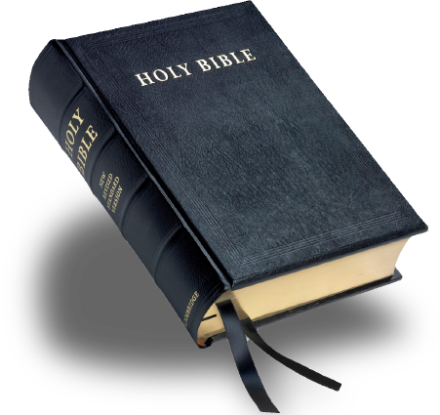
Psalm 118:24
Make Me a Servant - Applied
In Humbleness of Spirit
“Whosoever therefore shall humble himself as this little child, the same is greatest in the kingdom of heaven.”
Matt. 18:4

Slide 3
Psalm 118:24
Make Me a Servant - Applied
In Worship and Adoration
“But the hour cometh, and now is, when the true worshippers shall worship the Father in spirit and in truth: for the Father seeketh such to worship him.”
John 4:23

Slide 4
Psalm 118:24
Make Me a Servant - Applied
In Application to the Word
“Be diligent to present yourself approved to God as a workman who does not need to be ashamed, accurately handling the word of truth.”
2 Tim. 2:15

Slide 5
Psalm 118:24
Make Me a Servant - Applied
In Service to One Other
“…walk in a manner worthy of the calling to which you have been called, with all humility and gentleness, with patience, bearing with one another in love.”
Eph. 4:1-2

Slide 6
Psalm 118:24
Make Me a Servant - Applied
In Example to the World
“Even so let your light shine before men; that they may see your good works, and glorify your Father who is in heaven.”
Matt. 5:16

Slide 7
Psalm 118:24
Make Me a Servant - Applied
In Seeking the Lost
“I will seek the lost, bring back the scattered, bind up the broken and strengthen the sick...”
Ezek. 34:16

Slide 8
Psalm 118:24
Make Me A Servant Part Two
Lord, Help Me To Be Your Humble Servant In All Things!
Psalm 118:24
An Application to the Words from Last Week’s “Make Me A Servant”

Slide 9
Psalm 118:24
Luke 17:10
“So likewise ye, when ye shall have done all those things which are commanded you, say, We are unprofitable servants: we have done that which was our duty to do.”
Psalm 118:24
An Application to the Words from Last Week’s “Make Me A Servant”

Slide 10
Psalm 118:24
Let Us Begin Our Worship Together
“God is Spirit, and Those Who Worship Him Must Worship in Spirit and Truth.”
John 4:24

