Slide 1
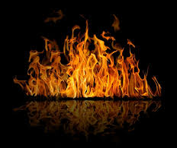
1Peter 4:1-8

Slide 2
1Peter 5:10

Slide 3
James 1:2

Slide 4
Luke 23:39-41

Slide 5
James 5:14-16

Slide 6
For to you it has been granted for Christ’s sake, not only to believe in Him, but also to suffer for His sake, experiencing the same conflict which you saw in me, and now hear to be in me. ~Philippians 1:29,30

