Slide 1
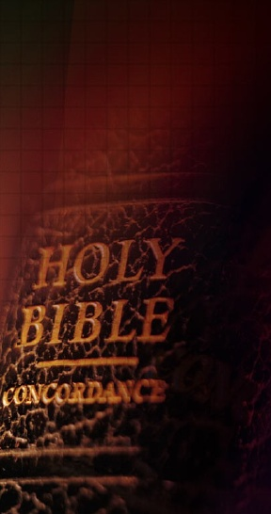
See That You Build it According to the Pattern Shown You
Gen. 6:13-22
Exodus 25:40

Slide 2
Build it According to the Pattern
God gave Noah a Pattern to Build the Ark
Gen. 6:14-22

Slide 3
Build it According to the Pattern
“Make thee an ark of gopher wood; rooms shalt thou make in the ark, and shalt pitch it within and without with pitch …Thus did Noah; according to all that God commanded him, so did he.”
Gen. 6:14-22

Slide 4
Build it According to the Pattern
God gave Moses a Pattern to Build the Tabernacle
Exodus 25:40

Slide 5
Build it According to the Pattern
“And see that thou make them after their pattern, which hath been showed thee in the mount.”
Exodus 25:40

Slide 6
Build it According to the Pattern
God gave Israel a Pattern for Work and Worship
Lev. 20:7-8

Slide 7
Build it According to the Pattern
“Sanctify yourselves therefore, and be ye holy; for I am Jehovah your God. And ye shall keep my statutes, and do them: I am Jehovah who sanctifieth you.”
Lev. 20:7-8

Slide 8
Build it According to the Pattern
God has given the Church a Pattern for Work and Worship
1 Cor. 3:10-11

Slide 9
Build it According to the Pattern
“…I laid a foundation; and another buildeth thereon. But let each man take heed how he buildeth thereon. For other foundation can no man lay than that which is laid, which is Jesus Christ.”
1 Cor. 3:10-11

Slide 10
God Punished Those in Israel Who Deviated from the Pattern Shown Them.

Slide 11
Deviating from the Pattern God has Shown to Us for Our Work and Worship will have Eternal Consequences.

Slide 12
We must Seek the “Old Paths” and Remain True to the Pattern God has given Us for Our Work and Our Worship.

Slide 13
Let Us Make Sure We Build and Hold on to the Pattern
“Shown Thee on the Mount.”

Slide 14
Build it According to the Pattern
“Thus saith the LORD, Stand ye in the ways, and see, and ask for the old paths, where is the good way, and walk therein, and ye shall find rest for your souls.”
Jeremiah 6:16

Slide 15
Let Us Begin Our Worship Together
“God is Spirit, and Those Who Worship Him Must Worship in Spirit and Truth.”
John 4:24

