Slide 1
Spiritual Message of the Week
Having Boldness to Enter in by a New and Living Way
Hebrews 10:19-27

Slide 2
Spiritual Message of the Week
Hebrews 10:19-27
“Having therefore, brethren, boldness to enter into the holiest by the blood of Jesus, by a new and living way, which he hath consecrated for us, through the veil, that is to say, his flesh; And having an high priest over the house of God; Let us…”

Slide 3
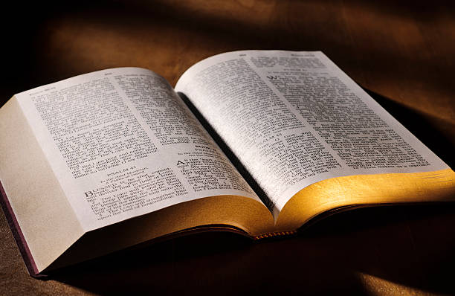
Having Therefore Boldness to Enter in, Let Us…
Draw Near with a Sincere Heart
“Let us draw near with a sincere heart in full assurance of faith, having our hearts sprinkled clean from an evil conscience and our bodies washed with pure water.”
Heb.
10:22

Slide 4
Having Therefore Boldness to Enter in, Let Us…
Hold Fast the Profession of Our Faith
Heb.
10:23
“Let us hold fast the profession of our faith without wavering; (for he is faithful that promised;)”

Slide 5
Having Therefore Boldness to Enter in, Let Us…
Provoke to Love and Good Works
Heb.
10:24
“And let us consider one another to provoke unto love and to good works:”

Slide 6
Having Therefore Boldness to Enter in, Let Us…
Not Forsake Assembling Together
Heb.
10:25
“Not forsaking the assembling of ourselves together, as the manner of some is…”

Slide 7
Having Therefore Boldness to Enter in, Let Us…
Exhort One Another
Heb.
10:25
“…but exhorting one another: and so much the more, as ye see the day approaching.”

Slide 8
Having Therefore Boldness to Enter in, Let Us…
Not Sin Willfully
Heb.
10:26
“For if we sin willfully after that we have received the knowledge of the truth, there remaineth no more sacrifice for sins…”

Slide 9
Having Therefore Boldness to Enter in, Let Us…
Not Sin Willfully
Heb.
10:27
“…but a certain fearful looking for of judgment and fiery indignation, which shall devour the adversaries.”

Slide 10
Lakeland Hills Blvd Church of Christ
Let Us Prepare Our Minds to Worship
“To the King of ages, immortal, invisible, the only God, be honor and glory forever and ever. Amen.”
1 Tim. 1:17

