Slide 1
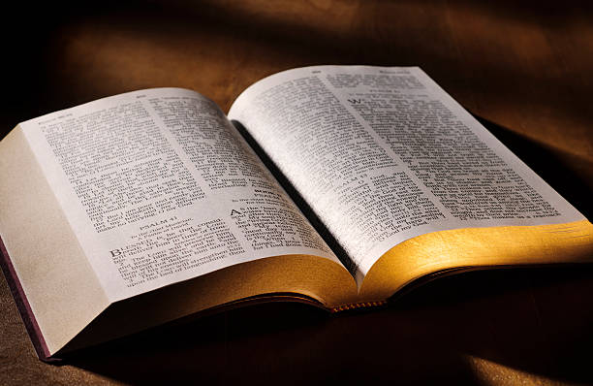
Spiritual Message of the Week
In What are God’s People to be Faithful?
1 Cor.
4:2
“Moreover it is required in stewards, that a man be found faithful.”

Slide 2
Spiritual Message of the Week
We are to be Faithful in Our Attitudes
1 Cor.
4:2
“Moreover it is required in stewards, that a man be found faithful.”

Slide 3
Spiritual Message – Faithfulness in Attitudes
Attitude Towards Christ’s Authority
“If any man speak, let him speak as the oracles of God; if any man minister, let him do it as of the ability which God giveth: that God in all things may be glorified through Jesus Christ, to whom be praise and dominion for ever and ever. Amen.”
1 Pet.
4:11

Slide 4
Spiritual Message – Faithfulness in Attitudes
Attitude Towards False Doctrine
1 John
4:1
“Beloved, believe not every spirit, but try the spirits whether they are of God: because many false prophets are gone out into the world.”

Slide 5
Spiritual Message – Faithfulness in Attitudes
Attitude Towards Those Who Teach
“How then shall they call on him in whom they have not believed? and how shall they believe in him of whom they have not heard? and how shall they hear without a preacher?”
Rom.
10:14

Slide 6
Spiritual Message – Faithfulness in Attitudes
Attitude Towards Our Fellow Brethren
“A new commandment I give unto you, That ye love one another; as I have loved you, that ye also love one another. By this shall all men know that ye are my disciples, if ye have love one to another.”
John
13:34-35

Slide 7
Spiritual Message – Faithfulness in Attitudes
Attitude Towards Reaching the Lost
Rom.
1:16
“For I am not ashamed of the gospel of Christ: for it is the power of God unto salvation to every one that believeth; to the Jew first, and also to the Greek.”

Slide 8
Spiritual Message – Faithfulness in Attitudes
Attitude Towards Our Worship Together
Rev.
14:7
“…Fear God, and give glory to him; for the hour of his judgment is come: and worship him that made heaven, and earth, and the sea, and the fountains of waters.”

Slide 9
Worship To Jehovah – The Almighty God
As We have Gathered Here Together, Let Us Prepare Our Minds to Worship Jehovah – The Almighty God.
Psalm
150:6
“Let everything that hath breath praise Jehovah. Praise ye Jehovah.”

