Slide 1
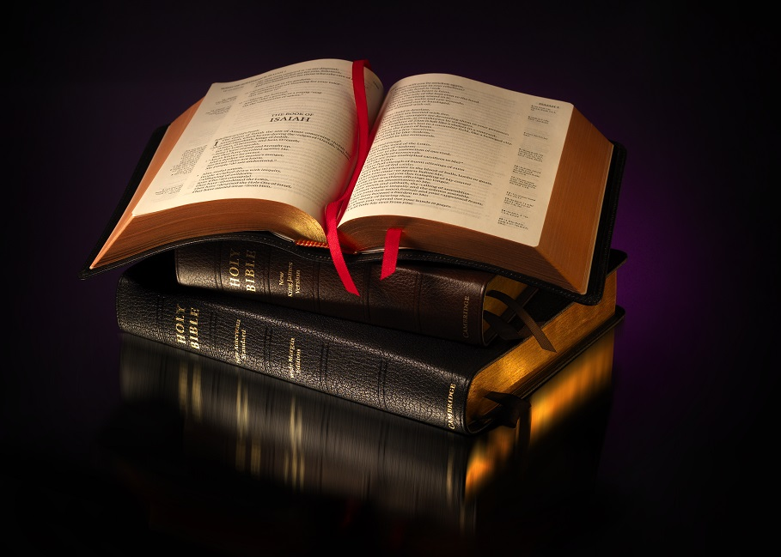
In What Are God’s People to be Faithful?
Part Two

Slide 2
In What Are Christians to be Faithful?
They are to be Faithful in Putting the Kingdom First
Matt. 6:33

Slide 3
In What Are Christians to be Faithful?
“But seek ye first the kingdom of God, and his righteousness; and all these things shall be added unto you.”
Matt.
6:33

Slide 4
In What Are Christians to be Faithful?
They are to be Faithful in Knowledge of God’s Word
2 Tim. 2:15

Slide 5
In What Are Christians to be Faithful?
“Give diligence to present thyself approved unto God, a workman that needeth not to be ashamed, handling aright the word of truth.” (ASV)
2 Tim.
2:15

Slide 6
In What Are Christians to be Faithful?
They are to be Faithful in Prayers to God Almighty
1 John 5:14-15

Slide 7
In What Are Christians to be Faithful?
“And this is the boldness which we have toward him, that, if we ask anything according to his will, he heareth us: and if we know that he heareth us whatsoever we ask, we know that we have the petitions which we have asked of him.”
1 John
5:14-15

Slide 8
In What Are Christians to be Faithful?
They are to be Faithful in Assembling Together
Heb. 10:23-25

Slide 9
In What Are Christians to be Faithful?
“let us hold fast the confession of our hope that it waver not; for he is faithful that promised: and let us consider one another to provoke unto love and good works; not forsaking our own assembling together, as the custom of some is, but exhorting one another; and so much the more, as ye see the day drawing nigh.” (ASV)
Heb.
10:23-25

Slide 10
In What Are Christians to be Faithful?
They are to be Faithful in Teaching Others
1 Pet. 3:15

Slide 11
In What Are Christians to be Faithful?
“But sanctify the Lord God in your hearts: and be ready always to give an answer to every man that asketh you a reason of the hope that is in you with meekness and fear.”
.”
1 Peter
3:15

Slide 12
In What Are Christians to be Faithful?
Let Us be Faithful in All Things, Always Abounding in the Work of the Lord
1 Cor. 15:58

Slide 13
Let Us Begin Our Worship Together
“Oh come, let us worship and bow down; let us kneel before the Lord, our Maker!”
Psalm 95:6

