Slide 1
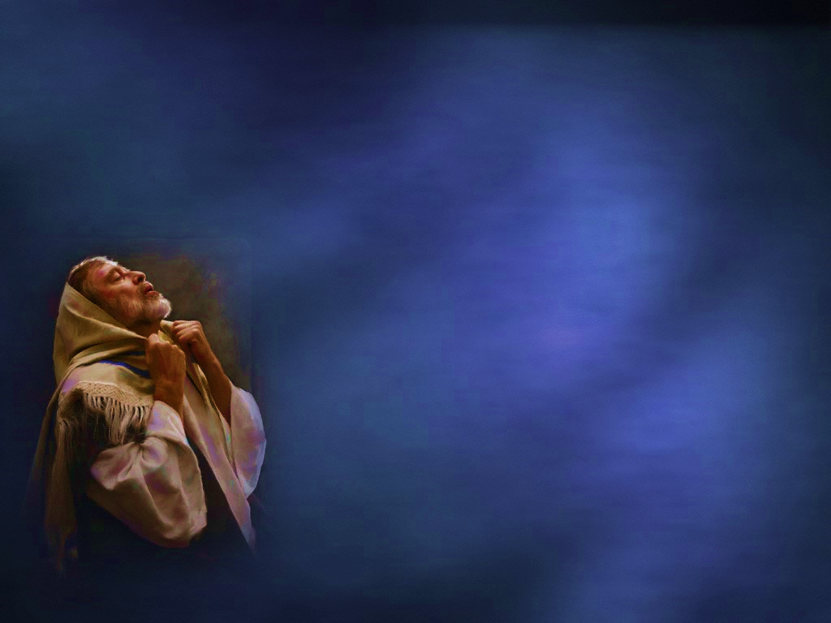
1 Peter 2:11-12
“Beloved, I urge you as sojourners and exiles to abstain from the passions of the flesh, which wage war against your soul. Keep your conduct among the Gentiles honorable, so that when they speak against you as evildoers, they may see your good deeds and glorify God on the day of visitation.”

Slide 2
1 Peter 2:11-12
Remember You Are
The Beloved of God
1 John 3:1

Slide 3
1 Peter 2:11-12
“See what kind of love the Father has given to us, that we should be called children of God; and so we are.”
1 John 3:1

Slide 4
1 Peter 2:11-12
Remember You are a
Pilgrim in a Foreign Land
Phil. 3:20-21

Slide 5
1 Peter 2:11-12
“But our citizenship is in heaven, and from it we await a Savior, the Lord Jesus Christ, Who shall change our vile body, that it may be fashioned like unto his glorious body, according to the working whereby he is able even to subdue all things unto himself.”
Phil. 3:20-21

Slide 6
1 Peter 2:11-12
You are in a War You
Cannot Afford to Lose
Eph. 6:12

Slide 7
1 Peter 2:11-12
“For we wrestle not against flesh and blood, but against principalities, against powers, against the rulers of the darkness of this world, against spiritual wickedness in high places.”
Eph. 6:12

Slide 8
1 Peter 2:11-12
We Must Defeat Our Critics
by Honorable Living
Matt. 5:16

Slide 9
1 Peter 2:11-12
“Be ye not unequally yoked together with unbelievers: for what fellowship hath righteousness with unrighteousness? and what communion hath light with darkness?”
2 Cor. 6:14

Slide 10
1 Peter 2:11-12
We Must Regard Critics as Possible Future Christians
Rev. 3:20

Slide 11
1 Peter 2:11-12
“Behold, I stand at the door, and knock: if any man hear my voice, and open the door, I will come in to him, and will sup with him, and he with me.”
Rev. 3:20

Slide 12
1 Peter 2:11-12
“Beloved, I urge you as sojourners and exiles to abstain from the passions of the flesh, which wage war against your soul. Keep your conduct among the Gentiles honorable, so that when they speak against you as evildoers, they may see your good deeds and glorify God on the day of visitation.”

Slide 13
Let Us Begin Our
Worship Together
“God is a Spirit: and they that worship him must worship him in spirit and in truth.”
John 4:24

