Slide 1

The Autonomy of the Local Church
“The Right of Self-Rule”

Slide 2
Autonomy of the Local Church
Each Congregation
Oversees its Own Work
1 Peter. 5:1-2

Slide 3
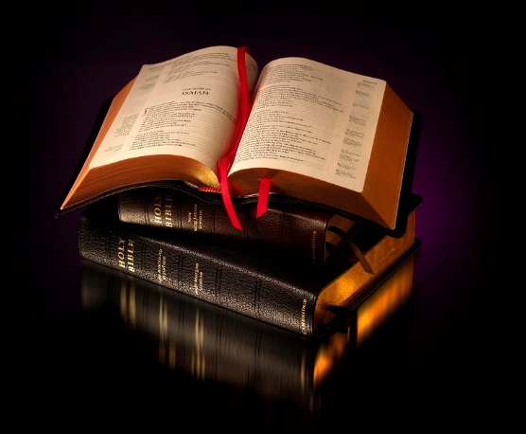
Overseeing Its Own Work
“The elders which are among you I exhort, who am also an elder, and a witness of the sufferings of Christ, and also a partaker of the glory that shall be revealed: Feed the flock of God which is among you, taking the oversight thereof…”
1 Peter 5:1-2

Slide 4
Autonomy of the Local Church
Each Congregation
Handles Its Own Affairs
1 Cor. 6:2-5

Slide 5
Handling Its Own Affairs
“Do ye not know that the saints shall judge the world? and if the world shall be judged by you, are ye unworthy to judge the smallest matters? Know ye not that we shall judge angels? how much more things that pertain to this life?”
1 Cor. 6:2-3

Slide 6
Handling Its Own Affairs
“If then ye have judgments of things pertaining to this life, set them to judge who are least esteemed in the church. I speak to your shame. Is it so, that there is not a wise man among you? no, not one that shall be able to judge between his brethren?”
1 Cor. 6:4-5

Slide 7
Autonomy of the Local Church
Each Congregation
Controls Its Own Resources
1 Cor. 16:1-2

Slide 8
Controls Its Own Resources
“Now concerning the collection for the saints, as I have given order to the churches of Galatia, even so do ye. Upon the first day of the week let every one of you lay by him in store, as God hath prospered him, that there be no gatherings when I come.”
1 Cor. 16:1-2

Slide 9
Autonomy of the Local Church
Each Congregation
Provides For Its Own Needy
Acts 4:34-35

Slide 10
Provides For Its Own Needy
“Neither was there any among them that lacked: for as many as were possessors of lands or houses sold them, and brought the prices of the things that were sold, And laid them down at the apostles' feet: and distribution was made unto every man according as he had need.”
Acts 4:34-35

Slide 11
Autonomy of the Local Church
Each Congregation
Protects Its Own Members
Acts 20:28

Slide 12
Protects Its Own Members
“Take heed therefore unto yourselves, and to all the flock, over the which the Holy Ghost hath made you overseers, to feed the church of God, which he hath purchased with his own blood.”
Acts 20:28

Slide 13
Autonomy of the Local Church
Congregations Cannot Legislate Its Own Laws
Galatians 1:8

Slide 14
Cannot Legislate Own Laws
“But though we, or an angel from heaven, preach any other gospel unto you than that which we have preached unto you, let him be accursed.”
Galatians 1:8

Slide 15

“Hold the pattern of sound words which thou hast heard from me, in faith and love which is in Christ Jesus.”
2 Tim.1:13

Slide 16
Let Us Begin Our Worship Together
“God is Spirit, and Those Who Worship Him Must Worship in Spirit and Truth.”
John 4:24

