Slide 1

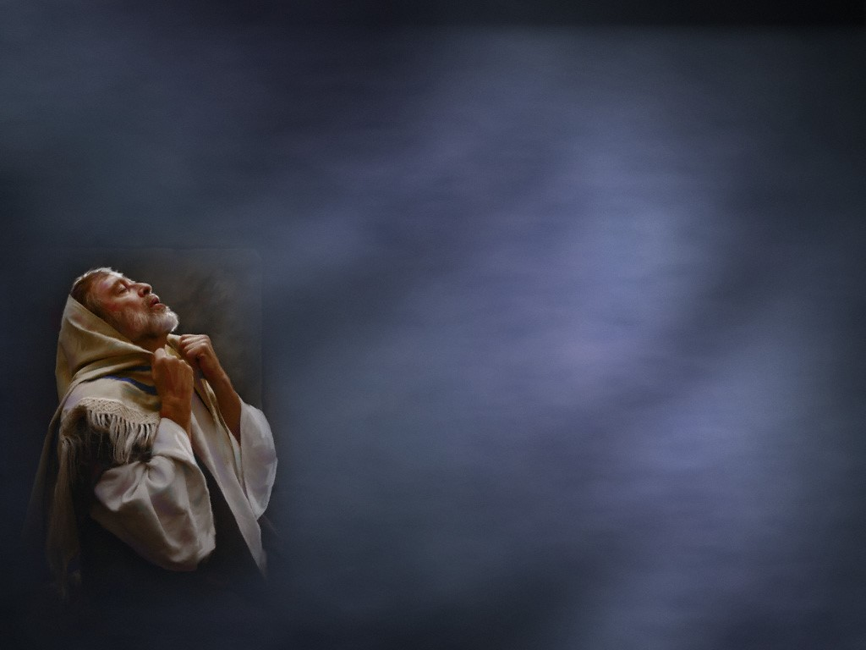
Spiritual Message of the Week
Why The Righteous
Do Not Beg
Psalm 37:25

Slide 2
Spiritual Message of the Week
“I have been young and now I am old, yet I have not seen the righteous forsaken or his descendants begging bread.”
Psalm 37:25

Slide 3
Why Righteous Do Not Beg
The Righteous are Richly Blessed by God
1 Tim. 6:17

Slide 4
Why Righteous Do Not Beg
“Every good thing given and every perfect gift is from above, coming down from the Father of lights.”
1 Tim. 6:17

Slide 5
Why Righteous Do Not Beg
The Righteous Will
Be Hard Workers
1 Thess. 4:11-12

Slide 6
Why Righteous Do Not Beg
“And that ye study to be quiet, and to do your own business, and to work with your own hands, as we commanded you; That ye may walk honestly toward them that are without, and that ye may have lack of nothing.”
1 Thess. 4:11-12

Slide 7
Why Righteous Do Not Beg
The Righteous Will
Be Good Stewards
Deut. 8:18

Slide 8
Why Righteous Do Not Beg
“But thou shalt remember the Lord thy God: for it is he that giveth thee power to get wealth, that he may establish his covenant which he sware unto thy fathers, as it is this day.”
Deut. 8:18

Slide 9
Why Righteous Do Not Beg
The Righteous Will
Be Content
1 Tim. 6:6-8

Slide 10
Why Righteous Do Not Beg
“But godliness with contentment is great gain. For we brought nothing into this world, and it is certain we can carry nothing out. And having food and raiment let us be therewith content.”
1 Tim. 6:6-8

Slide 11
Why Righteous Do Not Beg
The Righteous Will Associate
With The Righteous
2 Cor. 6:14

Slide 12
Why Righteous Do Not Beg
“Be ye not unequally yoked together with unbelievers: for what fellowship hath righteousness with unrighteousness? and what communion hath light with darkness?”
2 Cor. 6:14

Slide 13
Why Righteous Do Not Beg
“But seek ye first the kingdom of God, and his righteousness; and all these things shall be added unto you.”
Matt. 6:33

Slide 14
Let Us Begin Our
Worship Together
“Give unto the Lord the glory due unto his name: bring an offering, and come before him: worship the Lord in the beauty of holiness.”
1 Chron. 16:29

