Slide 1
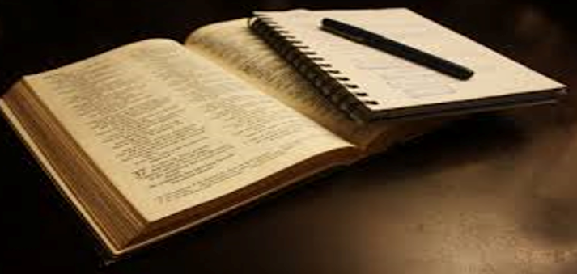
Spiritual Message
The Spirit of Worship

Slide 2
Worship Defined
To honor or show reverence for a divine being or supernatural power: To regard with great or extravagant respect, honor, or devotion.
“Come, let us worship and bow down, Let us kneel before the LORD our Maker.”
Psalm 95:6

Slide 3
The Spirit of Worship
Is A Spirit of Anticipation
“My soul thirsts for God, for the living God. When shall I come and appear before God?”
Psalm
42:2

Slide 4
The Spirit of Worship
Is A Spirit of Gratitude
“Enter into His gates with thanksgiving, and into His courts with praise. Be thankful to Him and bless his name!”
Psalm
100:4

Slide 5
The Spirit of Worship
Is A Spirit of Humility
“He has told you, O man, what is good; and what does the Lord require of you but to do justice, and to love kindness, and to walk humbly with your God.”
Micah
6:8

Slide 6
The Spirit of Worship
Is A Spirit of Awe Before God
“Let All the earth fear the Lord; Let all the inhabitants of the world stand in awe of Him.”
Psalm
33:8

Slide 7
The Spirit of Worship
Is A Spirit of Joy
“Praise the Lord! I will praise the Lord with my whole heart, in the assembly of the upright and in the congregation.”
Psalm
111:1

Slide 8
The Spirit of Worship
Is A Spirit of Unity
“Finally, be ye all likeminded, compassionate, loving as brethren, tenderhearted, humble-minded, not rendering evil for evil or reviling for reviling but contraiwise blessing; for hereunto were you called.”
1 Peter 3:8-9

Slide 9
The Spirit of Worship
Is A Spirit of Exaltation
Psalm
34:3
“O magnify the Lord with me, and let us exalt His name together.”

Slide 10
The Spirit of Worship
Is A Spirit of Holiness
“Give unto the Lord the glory due his name; Worship the Lord in the beauty of Holiness.”
Psalm
29:2

Slide 11
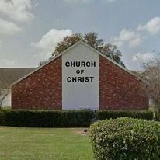
Lakeland Hills Boulevard Church of Christ
Let Us Begin Our Worship Together
“Wherefore, receiving a kingdom that cannot be shaken, let us have grace, whereby we may offer service well-pleasing to God with reverence and awe.”
Heb 12:28

