Slide 1
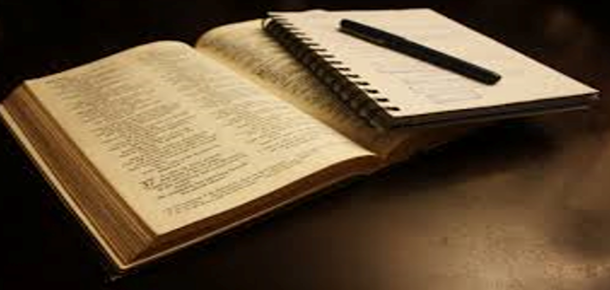

Lakeland Hills Blvd Church of Christ
“And when he had taken the book, the four beasts and four and twenty elders fell down before the Lamb, having every one of them harps, and golden vials full of odours, which are the prayers of saints.”
Rev.
5:8
Revelation 5:8-14 – The Throne Scene where Jesus has ascended back to Heaven:

Slide 2
Lakeland Hills Blvd Church of Christ
“And they sung a new song, saying, Thou art worthy to take the book, and to open the seals thereof: for thou wast slain, and hast redeemed us to God by thy blood out of every kindred, and tongue, and people, and nation;”
Rev.
5:9
Revelation 5:8-14 – The Throne Scene where Jesus has ascended back to Heaven:

Slide 3
Lakeland Hills Blvd Church of Christ
“And hast made us unto our God kings and priests: and we shall reign on the earth. And I beheld, and I heard the voice of many angels round about the throne and the beasts and the elders: and the number of them was ten thousand times ten thousand, and thousands of thousands.”
Rev.
5:10-11
Revelation 5:8-14 – The Throne Scene where Jesus has ascended back to Heaven:

Slide 4
Lakeland Hills Blvd Church of Christ
Rev.
5:12
“Saying with a loud voice, Worthy is the Lamb that was slain to receive power, and riches, and wisdom, and strength, and honour, and glory, and blessing.”
Revelation 5:8-14 – The Throne Scene where Jesus has ascended back to Heaven:

Slide 5
Lakeland Hills Blvd Church of Christ
“And every creature which is in heaven, and on the earth, and under the earth, and such as are in the sea, and all that are in them, heard I saying, Blessing, and honour, and glory, and power, be unto him that sitteth upon the throne, and unto the Lamb for ever and ever.”
Rev.
5:13
Revelation 5:8-14 – The Throne Scene where Jesus has ascended back to Heaven:

Slide 6
Lakeland Hills Blvd Church of Christ
Rev.
5:14
“And the four beasts said, Amen. And the four and twenty elders fell down and worshipped him that liveth for ever and ever.”
Revelation 5:8-14 – The Throne Scene where Jesus has ascended back to Heaven:

Slide 7

Lakeland Hills Blvd Church of Christ
Welcome to Our
Sunday AM Worship Service
“…let us continually offer up a sacrifice of praise to God, that is, the fruit of lips that acknowledge his name.”
Heb. 13:15
As We have Gathered Together, Let Us Prepare Our Minds to Worship Jehovah Our God.

