Slide 1

Spiritual Message
to Help Prepare Our
Minds For Worship

Slide 2
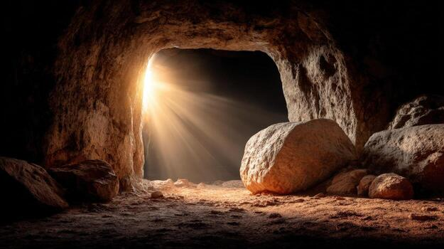
Spiritual Thoughts to Prepare Us For Worship
The Empty
Tomb
He is Not Here - For He Has Risen!
Matt. 28:6

Slide 3
The Empty Tomb Means That…
Christ Has Been Resurrected
1 Cor. 15:20
But Christ has indeed been raised!

Slide 4
The Empty Tomb Means That…
Christ Reigns In Heaven
Heb. 1:3
Seated At The Right Hand of God!

Slide 5
The Empty Tomb Means That…
Christ Prepared A Way for Us
John 14:6
I Am The Way. The Truth and the Life!

Slide 6
The Empty Tomb Means That…
Christ Saves Us By His Shed Blood
Rev. 1:5
Has Freed Us From Sin By His Blood!

Slide 7
The Empty Tomb Means That…
Sins Are Washed Away in Baptism
Rom. 6:4
Buried in Baptism – Raised Walk New Life!

Slide 8
The Empty Tomb Means That…
An Obedient Life Will Gain An Eternal Reward
Luke 6:23
Behold, Your Reward is Great in Heaven!

Slide 9
“Therefore, since we are surrounded by so great a cloud of witnesses, let us also lay aside every weight, and sin which clings so closely, and let us run with endurance the race that is set before us, looking to Jesus, the founder and perfecter of our faith, who for the joy that was set before him endured the cross, despising the shame, and is seated at the right hand of the throne of God.”
Heb. 12:1-2

Slide 10
Time To Begin Our Worship Zo Almighty God
Let Us Humbly and Reverently Begin Our Worship to the Lord God Almighty
“Through him then let us continually offer up a sacrifice of praise to God, that is, the fruit of lips that acknowledge his name.”
Heb. 13:15

