Slide 1
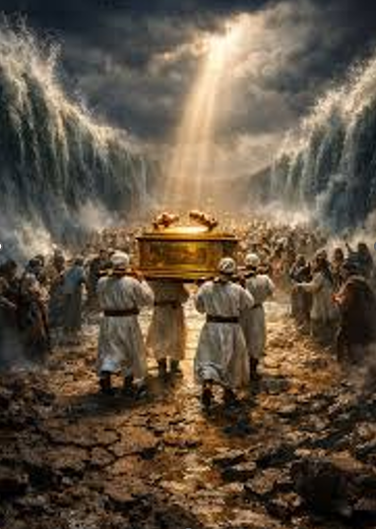
ISRAEL CROSSING THE JORDAN
The Lord Told Joshua To Go Over The Jordan To The Land He Had Given To Israel. God Told Him; “I Will Not Leave You Or Forsake You.” “Be Strong And Very Courageous.” “Observe To Do According To All The Law.”
Joshua 1:1-7

Slide 2
ISRAEL CROSSING THE JORDAN
It was during the flood season, so the Jordan would have been overflowing its banks and the current very strong.
Without God’s help, crossing the Jordan into the land of Canaan would have been impossible.
Joshua 1:1-7

Slide 3
ISRAEL CROSSING THE JORDAN
When the Priests that bore the Ark of the Covenant stepped into the waters, God caused the waters to stand up in a heap and all of Israel crossed over on dry ground.
Joshua 1:1-7

Slide 4
LESSONS WE CAN ALL LEARN
God Helps Us Overcome The Obstacles That We Cannot Overcome Alone
“For I, the LORD your God, hold your right hand; it is I who say to you, “Fear not, I am the one who helps you.”
Isaiah 41:13

Slide 5
LESSONS WE CAN ALL LEARN
God Gives Us Strength To Face Trials and Difficulties In Our Life
“God is our refuge and strength, a very present help in trouble. Therefore, we will not fear...”
Psalm 46:1-2

Slide 6
LESSONS WE CAN ALL LEARN
God Does Not Leave His People Without Evidence of His Presence Among Them
“You make known to me the path of life; in your presence there is fullness of joy; at your right hand are pleasures forevermore.”
Psalm 23:4

Slide 7
LESSONS WE CAN ALL LEARN
God Helps Us Regardless of The Time and Current Circumstances.
“For everything there is a season, and a time for every matter under heaven.”
Eccl. 3:1

Slide 8
LESSONS WE CAN ALL LEARN
God Helps Us To Have A Working Faith That Is Active
“For we are his workmanship, created in Christ Jesus for good works, which God prepared beforehand, that we should walk in them.”
Eph. 2:10

Slide 9
LESSONS WE CAN ALL LEARN
There is A “Jordan” Between Us And The Promised Land That Awaits. With God’s Help, We Will Cross Over!

