Slide 1
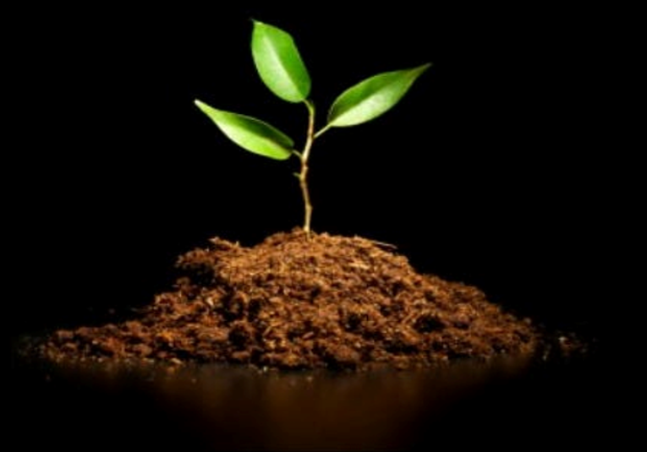
Growing In The Spirit

Slide 2

Growing In The Spirit
2 Peter 3:18
“But grow in the grace and knowledge of our Lord and Savior Jesus Christ. To him be the glory both now and to the day of eternity. Amen.”

Slide 3
Growth Happens Thru
The Word of God
“Like newborn infants, long for the pure spiritual milk, that by it you may grow up into salvation.”
1 Peter 2:2

Slide 4
Growth Happens By
Placing Our Trust In God
“Trust in Jehovah with all thy heart, And lean not upon thine own understanding: in all thy ways acknowledge him, And he will direct thy paths.”
Prov. 3:5-6

Slide 5
Growth Happens Thru
Spiritual Transformation
“And we all, with unveiled face, beholding the glory of the Lord, are being transformed into the same image from one degree of glory to another, For this comes from the Lord...”
2 Cor. 3:18

Slide 6
Growth Happens By
Having the Mind of Christ
“But whoever keeps his word, in him truly the love of God is perfected. By this we may know that we are in him: whoever says he abides in him ought to walk in the same way in which he walked.”
1 Jn. 2:5-6

Slide 7
Growth Happens By
Becoming Spiritual Mature
“But solid food is for the mature, for those who have their powers of discernment trained by constant practice to distinguish good from evil.”
Heb. 5:14

Slide 8
Growing in the Spirit
“I beseech you therefore, brethren, by the mercies of God, to present your bodies a living sacrifice, holy, acceptable to God, which is your spiritual service. And be not fashioned according to this world: but be ye transformed by the renewing of your mind, that ye may prove what is the good and acceptable and perfect will of God.”
Rom. 12:1-2

