Slide 1
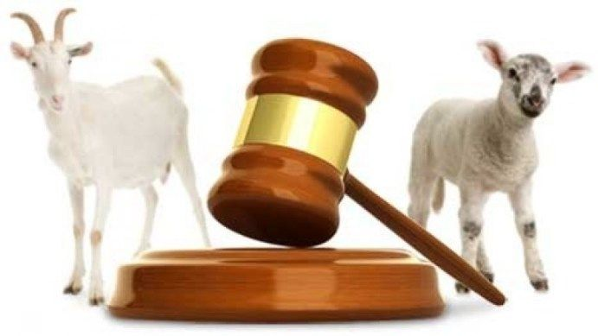
Separating the
Sheep from the Goats
Matthew 25:31-46

Slide 2
Matt. 25:31-33
“When the Son of man shall come in his glory, and all the holy angels with him, then shall he sit upon the throne of his glory: And before him shall be gathered all nations…

Slide 3
Matt. 25:31-33
“…and he shall separate them one from another, as a shepherd divideth his sheep from the goats: And he shall set the sheep on his right hand, but the goats on the left.”

Slide 4
Matt. 25:34-36
“Then shall the King say unto them on his right hand, Come, ye blessed of my Father, inherit the kingdom prepared for you from the foundation of the world…

Slide 5
Matt. 25:34-36
For I was an hungred, and ye gave me meat: I was thirsty, and ye gave me drink: I was a stranger, and ye took me in: Naked, and ye clothed me: I was sick, and ye visited me: I was in prison, and ye came unto me.”

Slide 6
Matt. 25:41-43
“Then shall he say also unto them on the left hand, Depart from me, ye cursed, into everlasting fire, prepared for the devil and his angels…

Slide 7
Matt. 25:41-43
“…For I was an hungred, and ye gave me no meat: I was thirsty, and ye gave me no drink: I was a stranger, and ye took me not in: naked, and ye clothed me not: sick, and in prison, and ye visited me not.”

Slide 8
Matt. 25:46
“And these shall go away into everlasting punishment: but the righteous into life eternal.”

Slide 9
Matthew 25:31-46
We Will All Be Judged For How We Have Lived

Slide 10
Matthew 25:31-46
Will I Be Among Sheep
Or Among The Goats?

Slide 11
Let Us Humbly and With Great Reverence, Respect And Awe Begin Our Worship to Almighty God!
“For from him and through him and to him are all things. To him be glory forever. Amen.”
Romans 11:36

