Slide 1
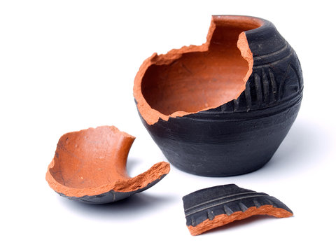
Broken Cisterns
“for my people have committed two evils: they have forsaken me, the fountain of living waters, and hewed out cisterns for
themselves, broken cisterns that
can hold no water.”
Jeremiah 2:13

Slide 2
Broken Cisterns
Israel have forsaken the Spiritual things of God who gave them “Living Water” and replaced them with things of the World that were
empty and vain “Broken Cisterns”.
Jeremiah 2:13

Slide 3
Broken Cisterns
When God’s people fail to maintain Him as the center of their lives and compromise with worldly things and influences, they replace
God with “Broken Cisterns” that will
Not hold the “Living Water” of life.
Jeremiah 2:13

Slide 4
Broken Cisterns
God’s instructions to Israel:
“Return to me with all your heart, with fasting, with weeping, and with mourning; and
rend your hearts and not your
garments.”
Joel 2:12-13

Slide 5
Broken Cisterns
God’s people must be careful that they are not digging their own cisterns, depending on them to satisfy their thirst and bring contentment.
They will find them broken and empty
when this life has come to an end.
Jeremiah 2:13

Slide 6
Broken Cisterns
Christ is the Living Water for Our Souls:
“If anyone thirsts, let him come to me and drink. Whoever believes in me, as the
Scripture has said, ‘Out of his heart
will flow rivers of living water.”
John 7:37-38

Slide 7
Broken Cisterns
“But whoever drinks of the water that I will give him will never be thirsty again. The water that
I will give him will become in him a spring
of water welling up to eternal life.”
John 4:14

Slide 8
Broken Cisterns
“For what does it profit a man to gain the whole world and forfeit his soul? For what can
a man give in return for his soul?.”
Mark 7:37-38

Slide 9
Broken Cisterns
Let us as the People of God, satisfy our thirst with the “Living Water” that only comes from God and which leads to eternal life.
“As a deer pants for flowing streams, so pants my soul for you, O God. My Soul thirsts for God, for the Living God”
Psalm 42:1-2

