Slide 1

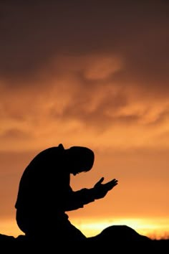
Who is Man To God?

Slide 2
Isaiah Compares Man to a Grasshopper
“It is he who sits above the circle of the earth, and its inhabitants are like grasshoppers.”
Isaiah 40:22

Slide 3
Job Compares Man to a Worm
How much less man, that is a worm! And the son of man, that is a worm!
Job 25:6

Slide 4
James Compares Men to a Vapor
“What is your life? For you are a vapor that appears for a little time and then vanishes.”
James 4:14

Slide 5
Jesus Compares Men to Sheep
“But when he saw the multitudes, he was moved with compassion for them, because they were distressed and scattered, as sheep not having a shepherd.”
Matt. 9:36

Slide 6
So, Who Am I To God?
“What is man that You are mindful of him, And the son of man that You visit him?”
Psalm 8:4

Slide 7
I Am A Child of God

Slide 8

I Am His Child For I Have Been Redeemed!
Col. 1:14

Slide 9
I am His Child for I Have Been Reconciled by The Blood of Christ!
“… and might reconcile them both in one body unto God through the cross, having slain the enmity thereby. ”
Eph. 2:16

Slide 10
Praise the Lord I Am His Child!

Slide 11

Praise the Lord, I am Forgiven,
and My Father Up in Heaven
Knows and Hears and Will be with Me
Praise the Lord! I am His Child!
Song # 15 – Hymns for Worship – I Am His Child

