Slide 1
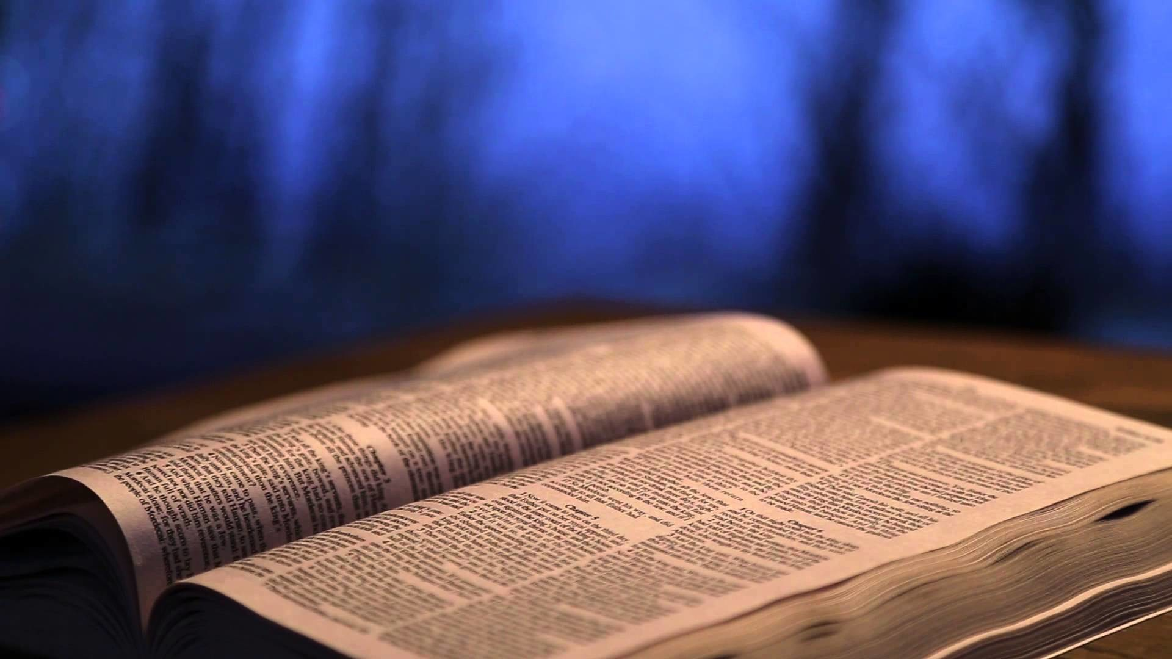
What Worshipers Know About God

Slide 2
Worshipers Know that God is Alive
“For I know that my Redeemer lives, and He shall stand at last on the earth.”
Job 19:25

Slide 3
Worshipers Know that God is Great
“For I know that the LORD is great, and our Lord is above all gods.”
Psalm 135:5

Slide 4
Worshipers Know that God is Greatly to be Praised
“For the LORD is great and greatly to be praised; He is to be feared above all gods…Give to the LORD the glory due His name.”
Psalm 96:4,8

Slide 5
Worshipers Know that God Saves
“Now I know that the LORD saves His anointed; He will answer him from His holy heaven with the saving strength of His right hand.”
Psalm 20:6

Slide 6
Worshipers Know They Can Trust in God
“…for I know whom I have believed and am persuaded that He is able to keep what I have committed to Him until that Day.”
2 Tim. 1:12

Slide 7
Let Us Begin Our Worship Of Praise To the Almighty God!
“Oh come, let us worship and bow down; Let us kneel before the LORD our Maker. For He is our God, and we are the people of His pasture.”
Psalm 96:6-7

