Slide 1
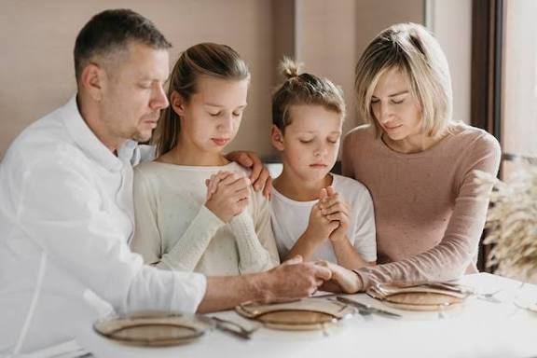
Living Modestly in Life
In Behavior, Speech, Dress and Actions
“For the LORD sees not as man sees: man looks on the outward appearance, but the LORD looks on the heart.”
1 Sam. 16:7

Slide 2
Having or showing a moderate or humble estimate of one’s merits, importance, etc.
Free from vanity, egotism, boastfulness, ostentation, extravagance, great pretensions.
Having regard for the decencies
of behavior, speech, dress, actions.

Slide 3
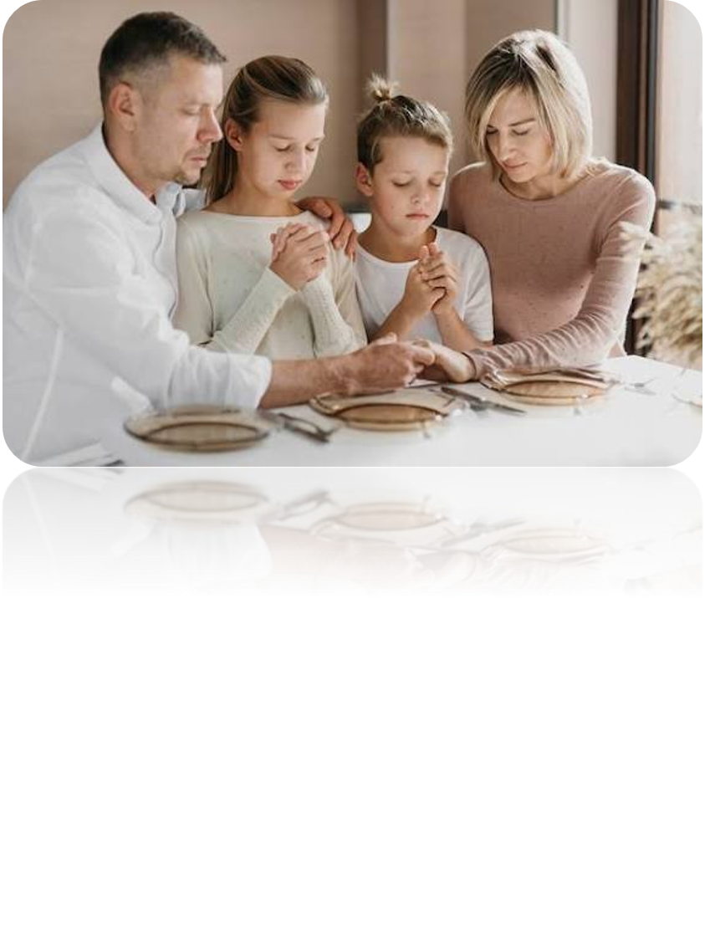
Modest in Our Behavior
A Humble Attitude
An Unselfish Heart
Showing Kindness
“Humble yourselves therefore under the mighty hand of God, that he may exalt you in due time.”
1 Pet. 5:6

Slide 4
Modest in Our Behavior
A Humble Attitude
An Unselfish Heart
Showing Kindness
“And as ye would that men should do to you, do ye also to them likewise.”
Luke 6:31

Slide 5
Modest in Our Speech
Not Boastful
Not Arrogant
Considerate
Pure in Speech
“But now ye rejoice in your boastings: all such rejoicing is evil.”
James 4:16

Slide 6
Modest in Our Speech
Not Boastful
Not Arrogant
Considerate
Pure in Speech
“Let your speech be alway with grace, seasoned with salt, that ye may know how ye ought to answer every man.”
Col. 4:6

Slide 7
Modest in Our Speech
Not Boastful
Not Arrogant
Considerate
Pure in Speech
“Neither filthiness, nor foolish talking, nor jesting, which are not convenient: …hath any inheritance in the kingdom of Christ and of God.”
Eph. 5:4-5

Slide 8
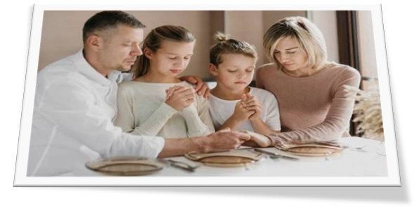
Modest in Our Appearance
Not Drawing Attention to Oneself
Not Uncovering One’s Body
Giving No Occasion for Lust
“Your beauty should not come from outward adornment… Rather, it should be that of your inner self, the unfading beauty of a gentle and quiet spirit, which is of great worth in God’s sight.”
1 Pet. 3:3-4

Slide 9
Modest in Our Appearance
Not Drawing Attention to Oneself
Not Uncovering One’s Body
Giving No Occasion for Lust
“Or do you not know that your body is a temple of the Holy Spirit within you, whom you have from God? You are not your own, for you were bought with a price. So glorify God in your body.”
1 Cor. 6:19-20

Slide 10
Modest in Our Appearance
Not Drawing Attention to Oneself
Not Uncovering One’s Body
Giving No Occasion for Lust
“For we are his workmanship, created in Christ Jesus for good works, which God prepared beforehand, that we should walk in them.”
Eph. 2:10

Slide 11
Living Modestly in Life
In Behavior, Speech, Dress and Action
“I beseech you therefore, brethren, by the mercies of God, to present your bodies a living sacrifice, holy, acceptable to God, which is your spiritual service. And be not fashioned according to this world: but be ye transformed by the renewing of your mind, that ye may prove what is the good and acceptable and perfect will of God.”
Rom. 12:1-2

Slide 12

Let Us Prepare Our Hearts And Minds As We Begin Our Worship To Almighty God!
“Through him then let us continually offer up a sacrifice of praise to God, that is, the fruit of lips that acknowledge his name.”
Heb. 13:15

